Slide 1
Meeting Week 25
Last week summary
  Problem definition
  System, model
  Only theta routing is NOT the solution
  The ANN is causing a drift problem
Augmentation
  Drift issue, can’t progress towards orthogonality with this
  System zero mean?
  Optimizer issue
Outline ToDo next week

Slide 2


Slide 3


Slide 4
Initial problem
After initialization immediate blow up → factor 100 worse
Issue stiffness matrix K only positions for Theta (X, Theta, Y)
K = [0, 0, 0;
0, kb1+kb2, 0;
0, 0, 0]
Resulted in ANN correction accumulating over my simulation steps without demping

Slide 5
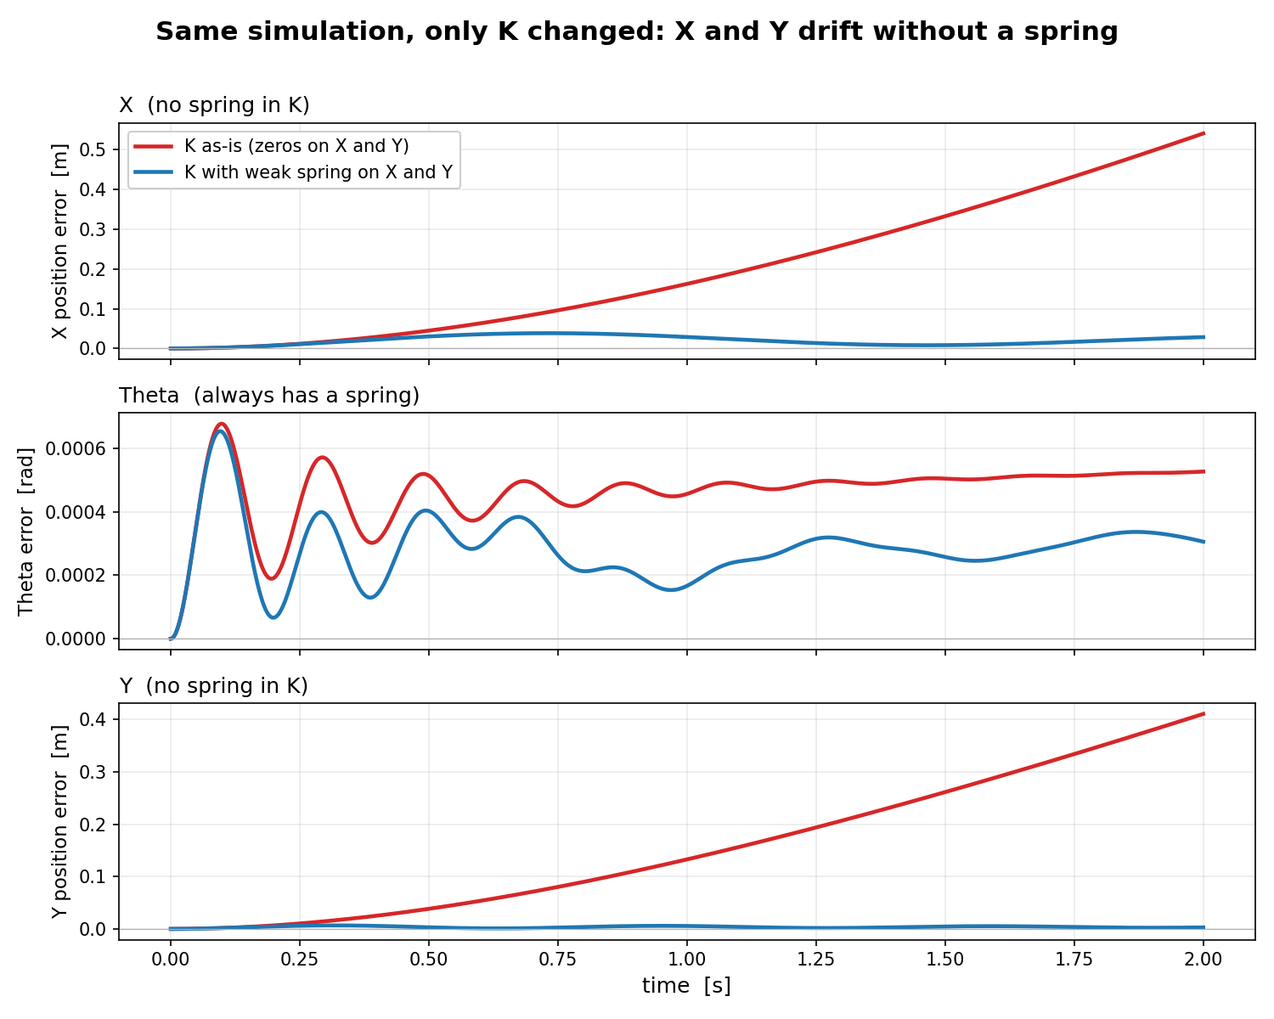
K = [0, 0, 0;
0, kb1+kb2, 0;
0, 0, 0]
Kb1+kb2 = 3975
Comparison:
K = [1000, 0, 0;
0, kb1+kb2, 0;
0, 0, 1000]
Open-loop run over full trajectory: sim-RMS
→ So only initial state
Notes:
Impuls input

Slide 6
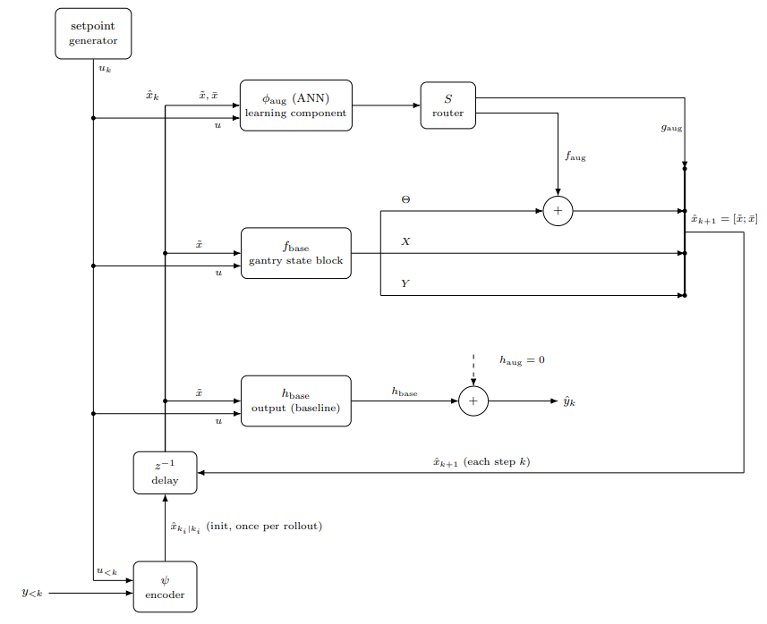
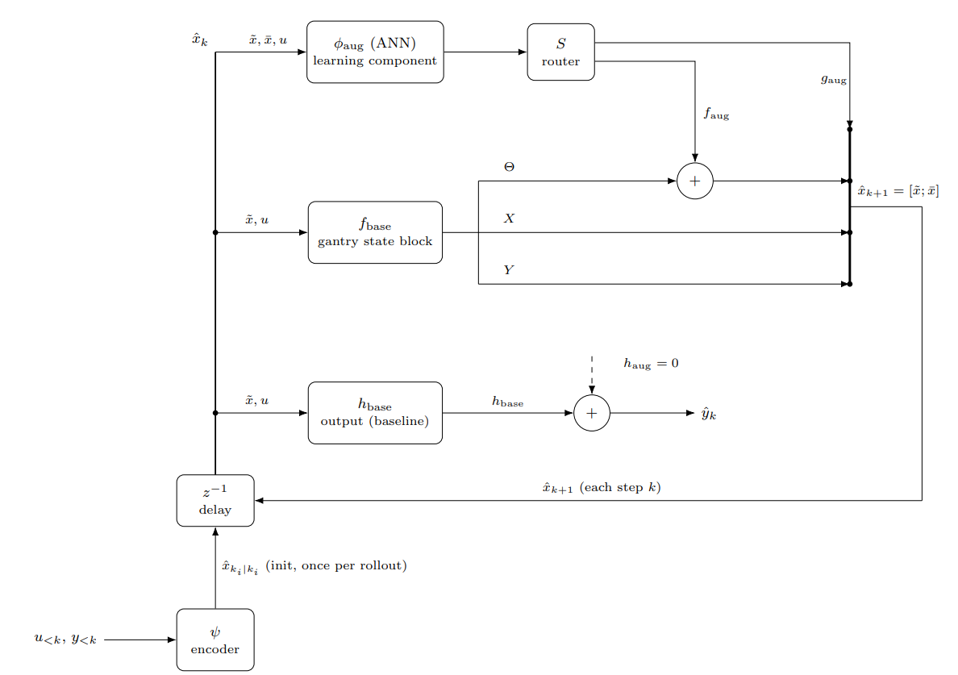

Slide 7
Added setpoint generator for the input u
(Due to coupling we HAVE to also route through X and Y)

Slide 8
Only theta routing not sufficient
Model is coupled
For correct augmentation the ANN needs to be able to enter X and Y
  Due to coupling I need to be able to route the ANN through X and Y aswell (off-diagonal terms)

Slide 9
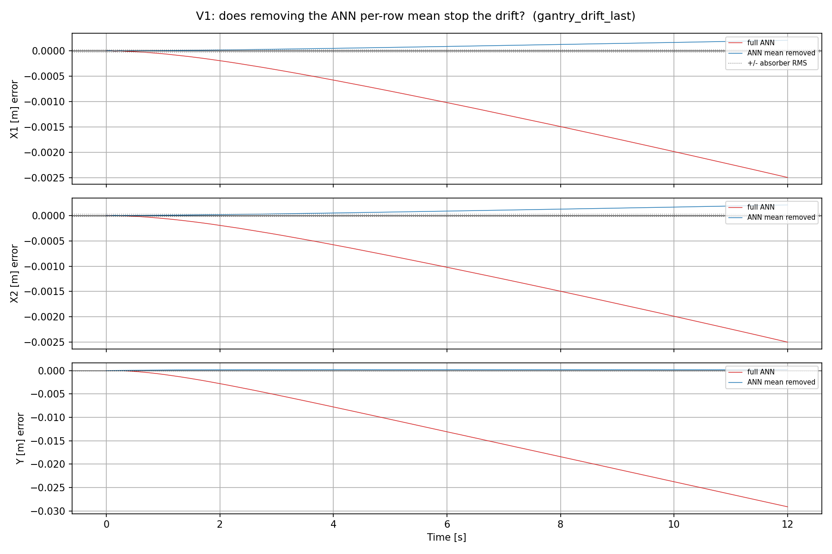
Drift with ANN
ANN creates:
  DC offset force added
Shows the error
Standstill trajectory at Y = 0.1 m with multisine 130-180hz
Notes:
Precisely, from the code: absorber_rms = data.val_x_aug[:, 0].std() — the standard deviation of the absorber's displacement δa over the V1 trajectory. That works out to ~2.19e-5 m ≈ 22 μm. It's plotted as two horizontal dotted lines at +22 μm and −22 μm (symmetric, because δa is a roughly zero-mean oscillation).What it represents: the hidden absorber (the 10%-mass MSD at 150 Hz) is exactly the unmodeled dynamics the augmentation exists to capture. Its displacement swings by ~22 μm RMS. So that band marks the scale of the thing the ANN should be learning.Why it's useful on an error plot: it turns the vertical axis into a "is this error meaningful?" yardstick:- Error inside the ±22 μm band → the residual is at absorber scale, i.e. the error is dominated by the very dynamics you're trying to model. That's the good regime.- Error outside the band → the error has grown beyond the signal itself, so it's no longer "unmodeled absorber," it's drift. On the untrained Y panel the ramp reaches ~110 μm ≈ 5× the band; on the trained figure the ANN reaches 2.6 cm ≈ 1000× the band. Both are "the error is now far bigger than the signal we care about.“
X and Y have no stiffness (K = 0). Their position is a free integrator — nothing pulls it back to a setpoint. (Physically: electric servo axes, no spring.)- Feed a constant force into such an axis: the velocity builds up to a terminal value (there's a little damping, so velocity itself stays bounded), but since that terminal velocity is nonzero and the position has no restoring stiffness, the position ramps forever. Constant force → constant drift rate → the curves you see (a short build-up, then a steady ramp to cm-scale).- Contrast with Theta (K > 0): there a constant force just produces a bounded position offset F/K — the spring balances the force and it settles. That's why Theta doesn't drift and X/Y do, under the same kind of ANN error.
So "DC-drift" = constant force × free integrator (no stiffness) = unbounded position growth. The stiffness is precisely what would stop it, and X/Y don't have it.
For your supervisor, the one-sentence version: the augmented model drifts because the ANN emits a small constant force on the stiffness-free X/Y axes, and a constant force on a free integrator integrates into unbounded position — proven by the fact that subtracting that constant removes the drift.
How it was trainedThe recipe (from the script's config):- Framework: Jan's SUBNET augmentation — the physics LPV-LFR gantry baseline in parallel with a small feedforward ANN (NX_ANN=2, 16 nodes, 2 layers, tanh) that adds corrections to the routed state rows. Encoder builds the initial state; training is windowed BPTT minimizing the nf-window simulation error with Adam.- Routing: full X+Θ+Y+absorber (0,1,2,3,4,5,6,7) — the deliverable routing, i.e. the ANN can write to the K=0 rows (that's what lets it drift).- Hyperparameters: lr = 1.49e-8, nf = 1400 (0.35 s window), 20 epochs, stride=100, validation on a cropped 8000-sample slice. Seed = cfg.seed + 3, mirroring Trial 3 of the Optuna search — the one config whose val sim-RMS actually moved past epoch 0 (6.58e-5 vs 8.01e-5), so its trained weights genuinely drift rather than staying at zero-init.- θ: nominal (joint_estimation=False) — free ANN on a correct physics baseline.- Data: the 14 noiseless augmentation simulation trajectories (standstill / ysweep / aprbs / lissajous), which contain the hidden 150 Hz MSD absorber the ANN is meant to learn.

Slide 10
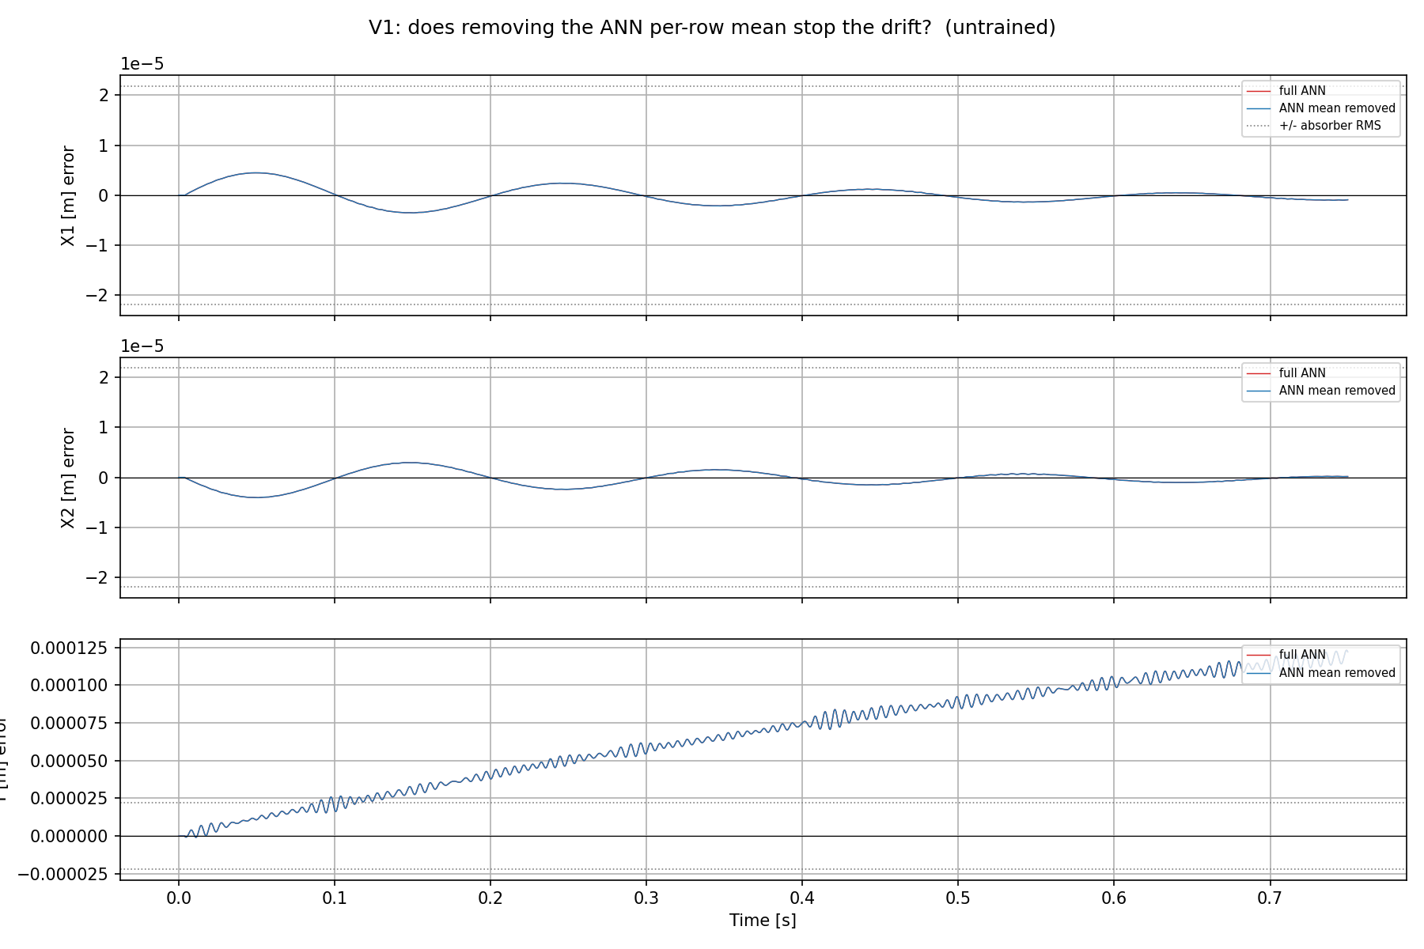
Drift with ANN
ANN at zero init:
  No DC offset force added
Shows the error
Standstill trajectory at Y = 0.1 m with multisine 130-180hz
Notes:
On the Y panel, look at the fine fast ripple riding on the ramp — that fast wiggle is the ~150 Hz content. It appears on Y specifically because the unmodeled absorber mass sits in the +Y direction (equilibrium offset L0 in +Y), so its mismatch imprints mainly on Y. Over 0.75 s that's ~110 cycles, so it reads as a dense ripple, not clean sinusoids.
"does removing the ANN's constant force stop the drift?" Untrained → the mean is ~0, so subtracting it changes nothing → it lies exactly on top of the red line (that overlap is the whole point of the control).
- "full ANN" (red): the free-run error using the ANN's complete output. Here (untrained) the ANN is zero-init, so this is effectively baseline + zero-ANN = the baseline free-run error.- "ANN mean removed" (blue): the counterfactual — the same free-run but with the ANN's per-row time-average (its DC/constant component) subtracted. This is the d6 test: "does removing the ANN's constant force stop the drift?" Untrained → the mean is ~0, so subtracting it changes nothing → it lies exactly on top of the red line (that overlap is the whole point of the control).- "+/- absorber RMS" (dotted horizontal lines at ±2.19e-5 m): the RMS of the absorber displacement — the scale of the signal the ANN is supposed to learn. It's a materiality yardstick: error inside the band is absorber-scale; the Y ramp climbing past it means the drift already exceeds the signal you care about.

Slide 11
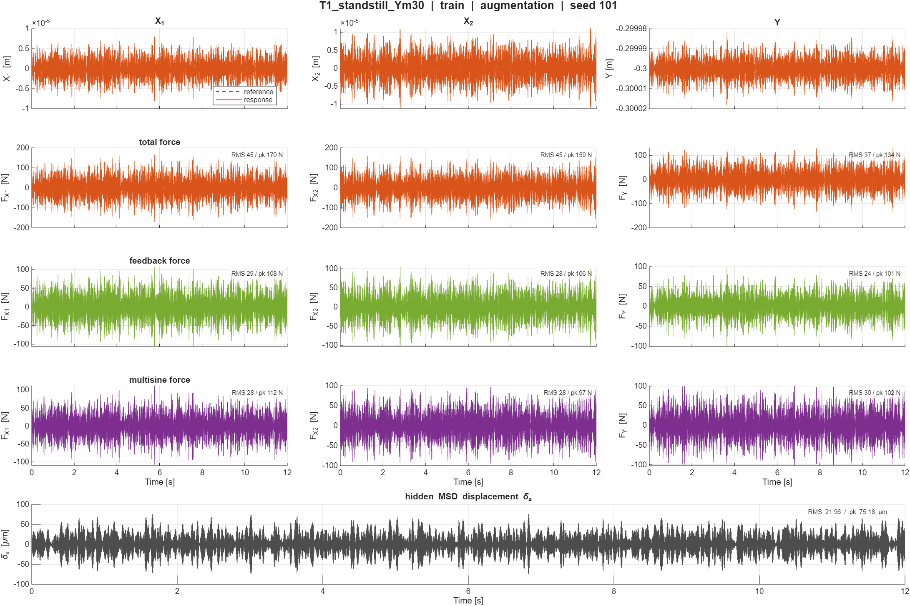

Slide 12
The problem – End of summary
The augmented model drifts in free-run
  The ANN leaves a small non-zero-mean (constant) force on the stiffness-free X/Y axes
  Nothing in the setup constrains that constant

Slide 13
Why the system requires to be zero-mean
Current implementation is made around zero-mean system:
  Xavier neural network weights initialization requires the system to be zero mean
  Input output normalization: subtract mean and divide by std
  Tanh activation: zero-centered and symmetric
  Loss + optimizer: MSE ↔ a zero-mean-Gaussian residual assumption
Notes:
compute_normalization subtracts the mean and divides by std precisely to manufacture the zero-mean/unit-variance inputs that Xavier and tanh assume. But it uses one pooled normalization. Our data has multiple operating points (Y ≈ 0.1–0.3 m), so each record's normalized signal still carries an O(1) constant offset from the pooled mean — the zero-mean assumption is satisfied on average, but violated per record. That's the Theme-B mismatch.

Slide 14
This is simultaneously an identifiability failure (the data do not constrain the direction) and a loss-blindness failure (the objective does not penalize it). The marginal integrator is the amplifier, not the cause.

Slide 15
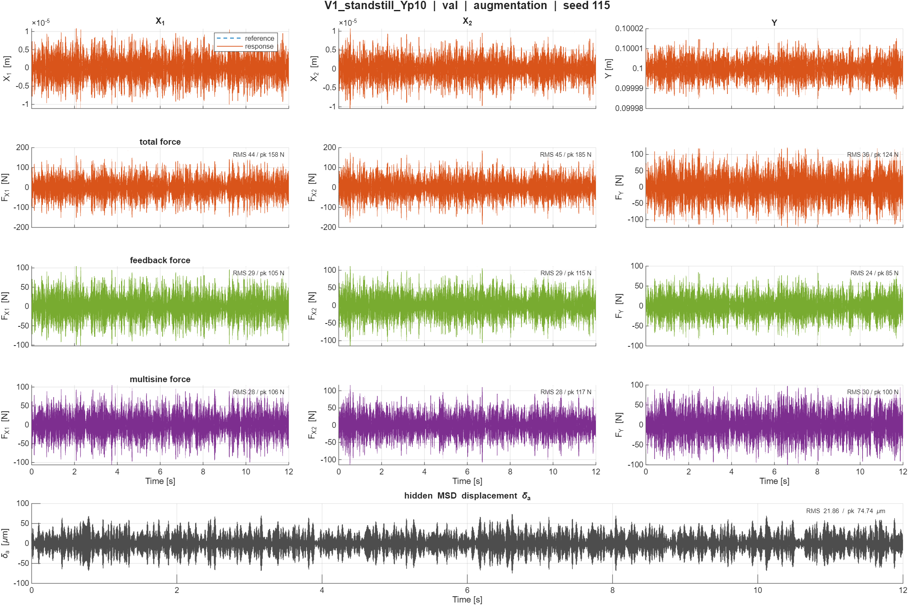
For context:
The data used for coming figures

Slide 16
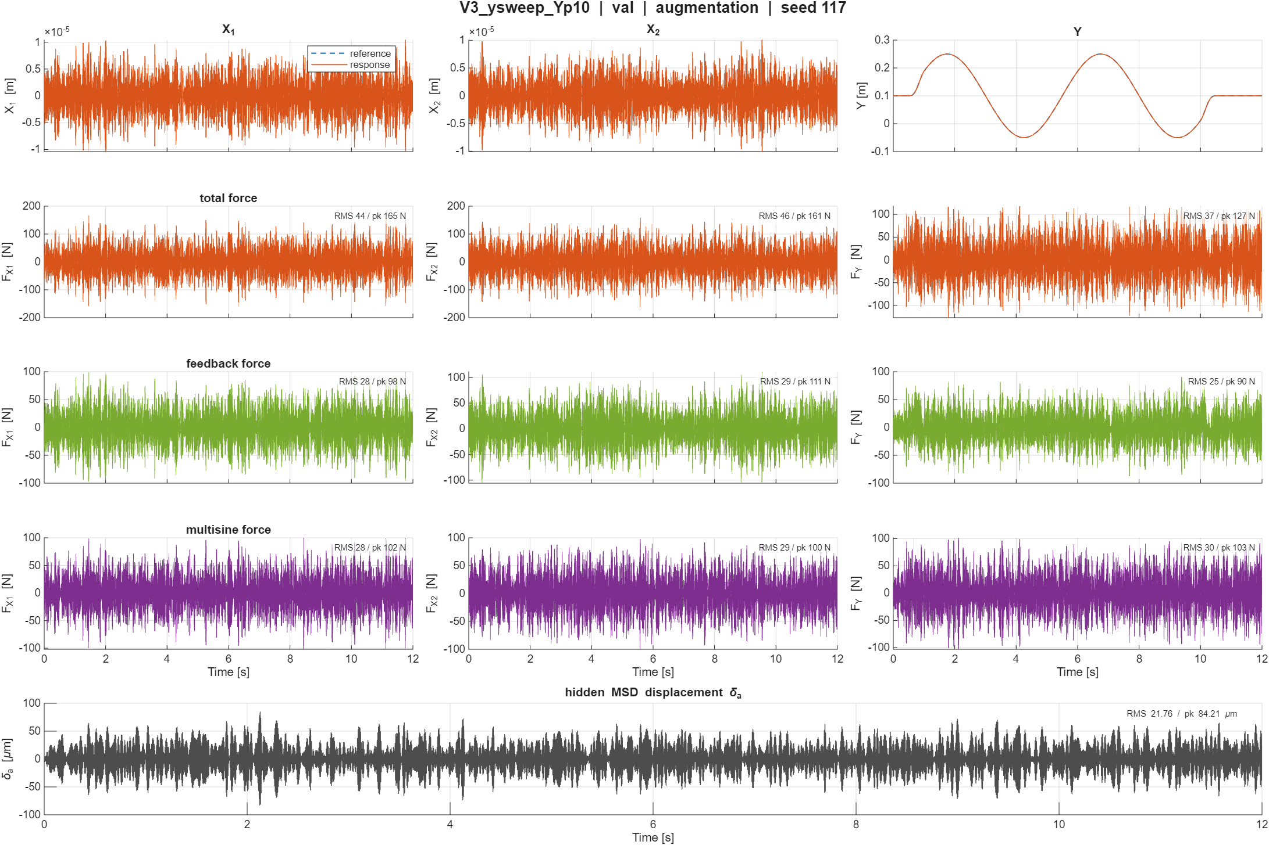

Slide 17
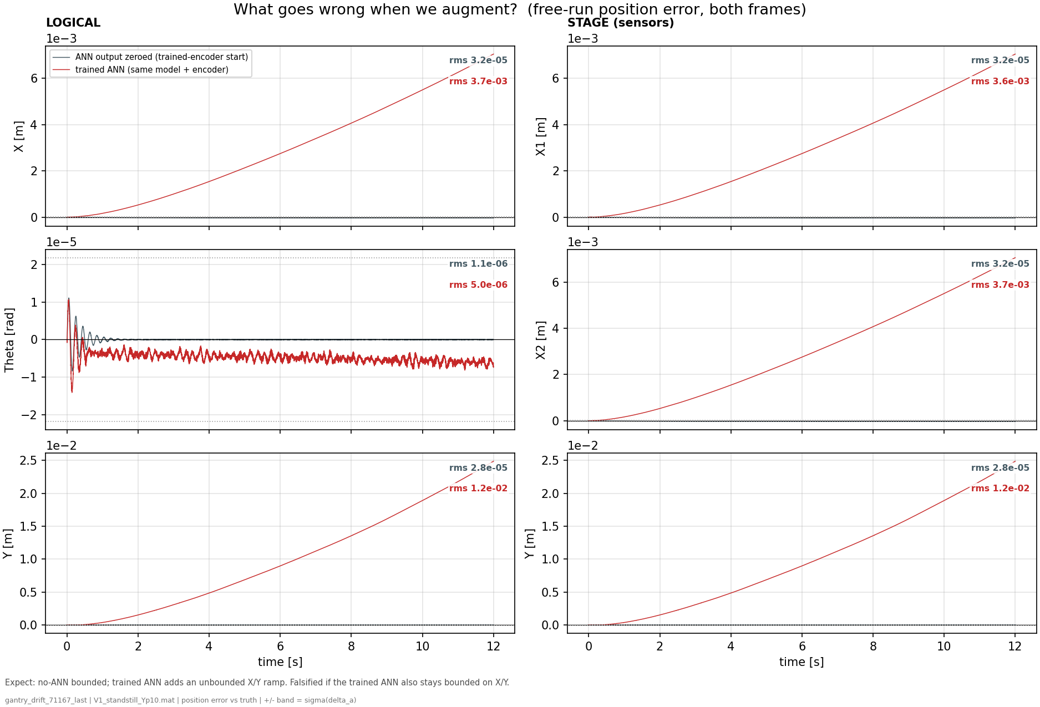
ANN adds drift
Notes:
f01 — the problem (free-run position error, trained ANN vs same model with ANN zeroed)- Shows: 12 s open-loop V1 free-run error against truth, all position channels, both frames; identical model/encoder, only the ANN output on or off.- Hypothesis: the augmentation should at worst do no harm; if it drifts, the ramp should appear on the stiffness-free axes only.- Conclusion: ANN off stays at the residual floor (rms ~3e-5 m); ANN on ramps to +7 mm on X and +25 mm on Y while sprung Theta only parks a bounded −5e-6 rad. The trained augmentation makes deployment ~400x worse, and the damage is exclusively on the K=0 axes.

Slide 18
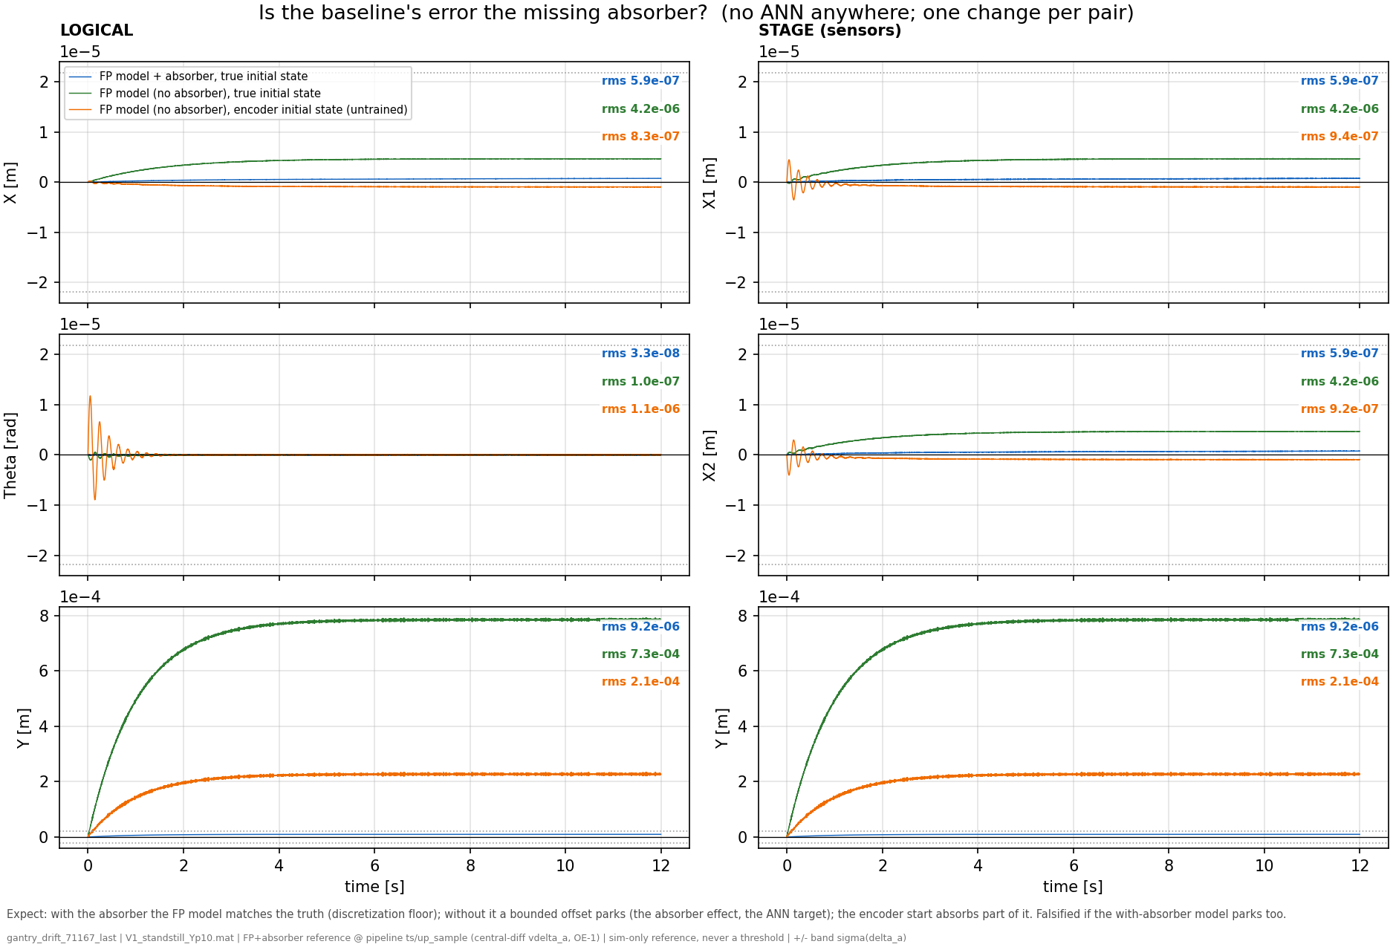
Added for training the true system: with the MSD
For comparison
Notes:
The ideal correction (the true absorber residual) is indeed zero-mean — we verified that (f03: the missing-absorber error parks instead of ramping, so no persistent mean-force gap exists).
f03 — is the baseline's error the missing absorber? (three runs, no ANN anywhere)- Shows: FP model with the true absorber from the true initial state (blue), without it from the true state (green), without it from the untrained-encoder state (orange).- Hypothesis: if baseline physics and data are sound, the with-absorber model sits at the discretization floor, and the green-blue gap is purely the absorber's effect.- Conclusion: blue at 9.2e-6 (floor), green parks a bounded +7.9e-4 on Y — the gap is the absorber effect, i.e. the ANN's legitimate target; orange (2.1e-4) shows the encoder absorbs part of it. Crucially: nothing here ramps — the baseline does not drift on its own.

Slide 19
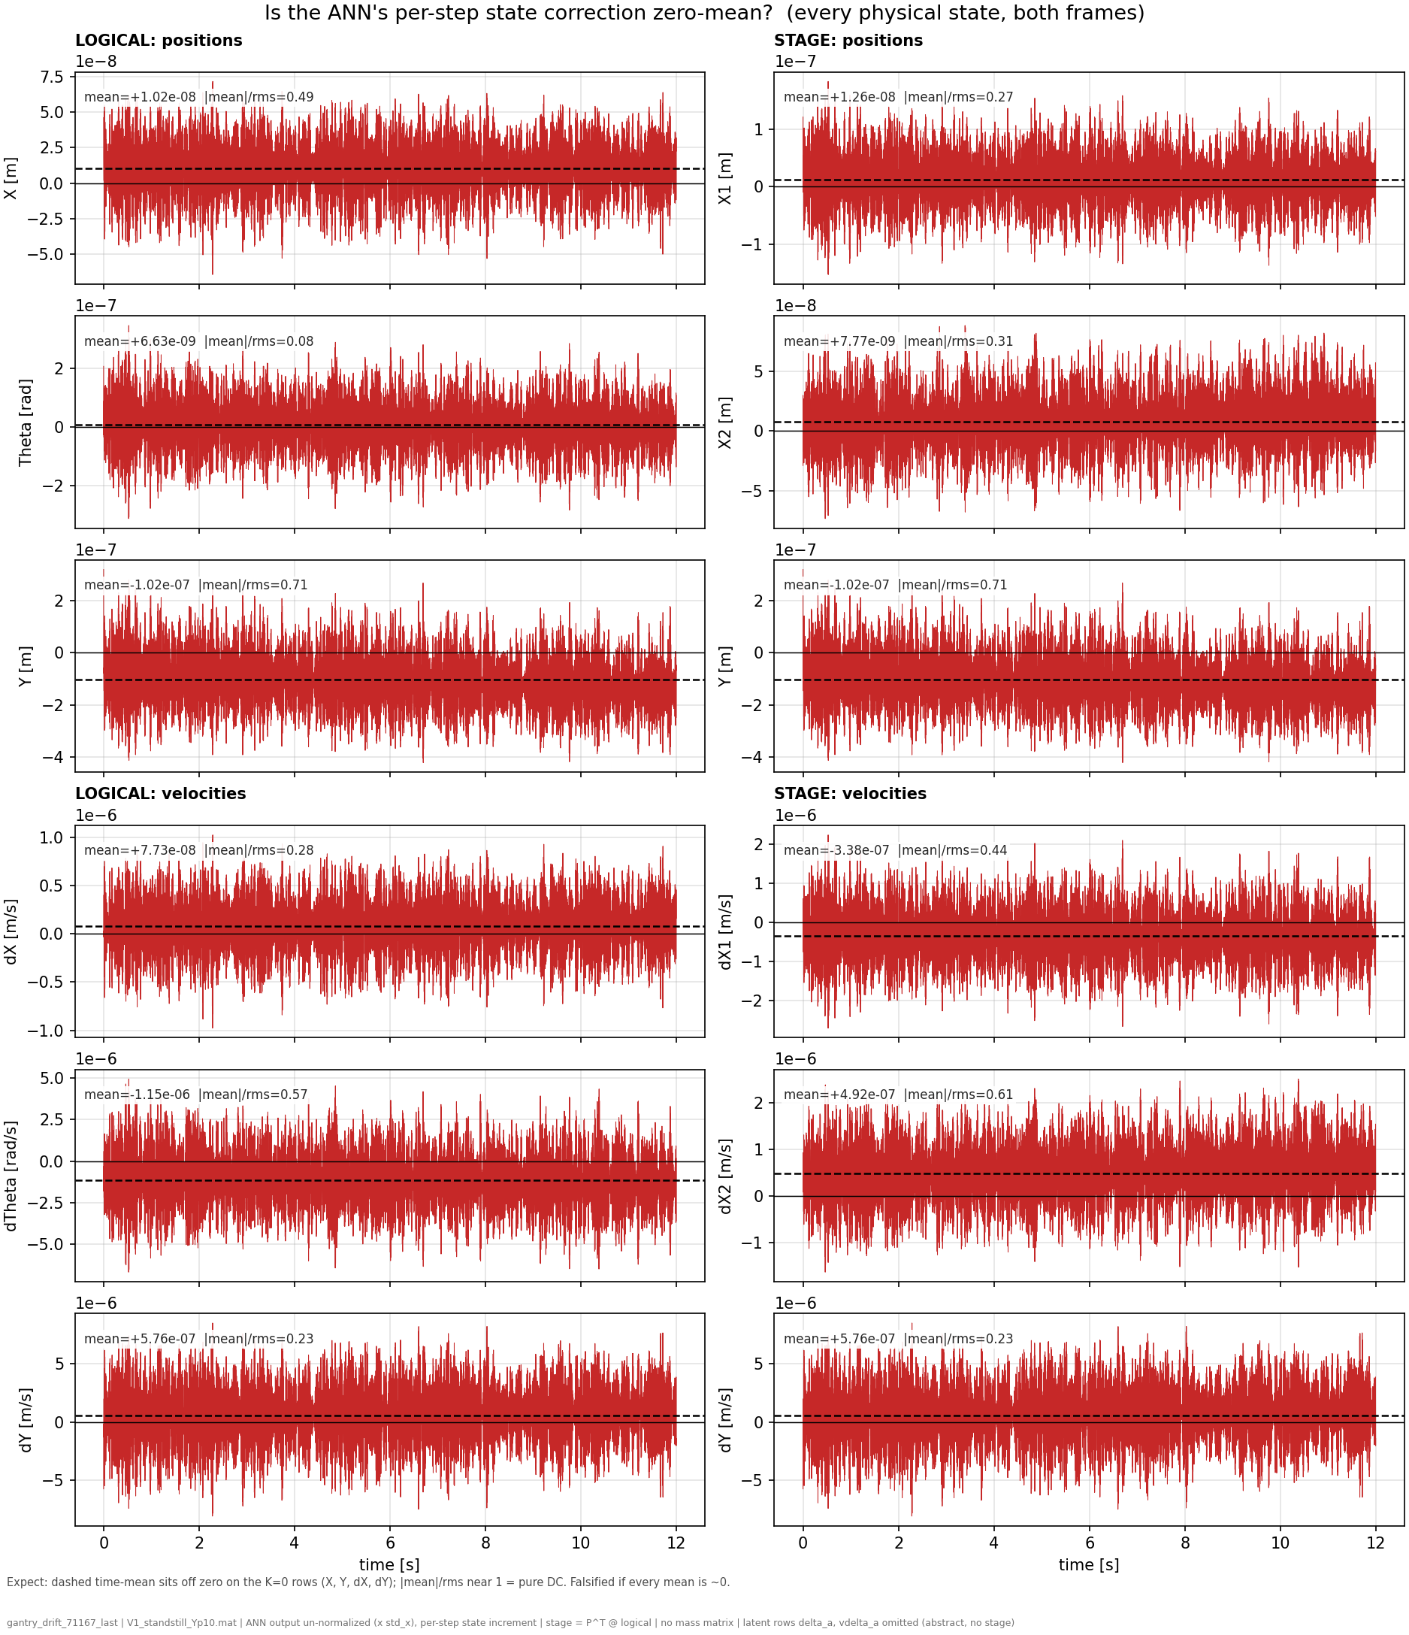
ANN correction to physical states
Look at the ANN correction to the physical states
Notes:
f04 shows the ANN's output signal itself
$$x\left[k+1\right]=\underbrace{\text{baseline} \text{physics} \text{step}\left(x\left[k\right],u\left[k\right]\right)}\text{FP} \text{model}+\underbrace{w\left[k\right]}\text{the} \text{ANN}\text{′}\text{s} \text{correction}$$
f04 — is the correction zero-mean? (the ANN's per-step output, all states, both frames)- Shows: the raw correction the ANN adds each step, with its time-mean (dashed) and |mean|/rms (0 = zero-mean, 1 = pure constant; squared = fraction of power at DC).- Hypothesis: Jan's expectation — the correction should be zero-mean, since its target is.- Conclusion: violated. Y row mean −1.0e-7 m/step with |mean|/rms 0.71 (half the power is a constant), dY +5.8e-7 with 0.23; Theta at 0.08 shows what genuine zero-mean looks like. The constants exist, and sit on the unprotected rows.

Slide 20
Zero-mean?
Ratio = 1
  The signal is essentially constant.
Ratio ≈ 0
  The signal oscillates around zero.
Y-position: 0.71
  MSD attached to Y-payload
Compared to Theta: 0.08
  Actual zero-mean

Slide 21
Notes:
So |mean|/rms is the fraction of the signal's magnitude that is the constant part, and it lives between 0 and 1:- = 0: perfectly zero-mean. The signal is all fluctuation (what your supervisor expected).- = 1: a pure constant, no fluctuation at all.
One important nuance when explaining it: the ratio measures how constant-like the signal is, not how harmful. On the stiffness-free axes, the fluctuating part is harmless (bounded response) while the constant part integrates into an unbounded ramp. So even the dY row's modest 0.23 matters enormously: it says a small-but-persistent constant is hiding under a mostly-fluctuating signal, and the integrator selectively amplifies exactly that part, without bound, while ignoring the other 95% of the power. The harm is set by the mean's absolute size times the horizon (that's f06 and f08), while |mean|/rms establishes the existence and purity of the constant.

Slide 22
Notes:
The cleanest evidence is a comparison f04 hands us for free: the dTheta row carries one of the largest constants of all (mean −1.15e-6 rad/s per step, |mean|/rms = 0.57 — bigger in relative purity and comparable in size to the drifting rows). If constants alone caused drift, Theta should drift hardest. It doesn't: f01 shows Theta parking at a bounded −5e-6 rad while X and Y, fed smaller constants, ramp to millimeters. Same injection type, opposite fates — and the only difference between those axes is the stiffness. The spring on Theta gives the constant something to push against (equilibrium shifts, done); X and Y have nothing, so the constant is integrated forever. That is the amplifier claim demonstrated within a single figure pair, on this checkpoint.

Slide 23
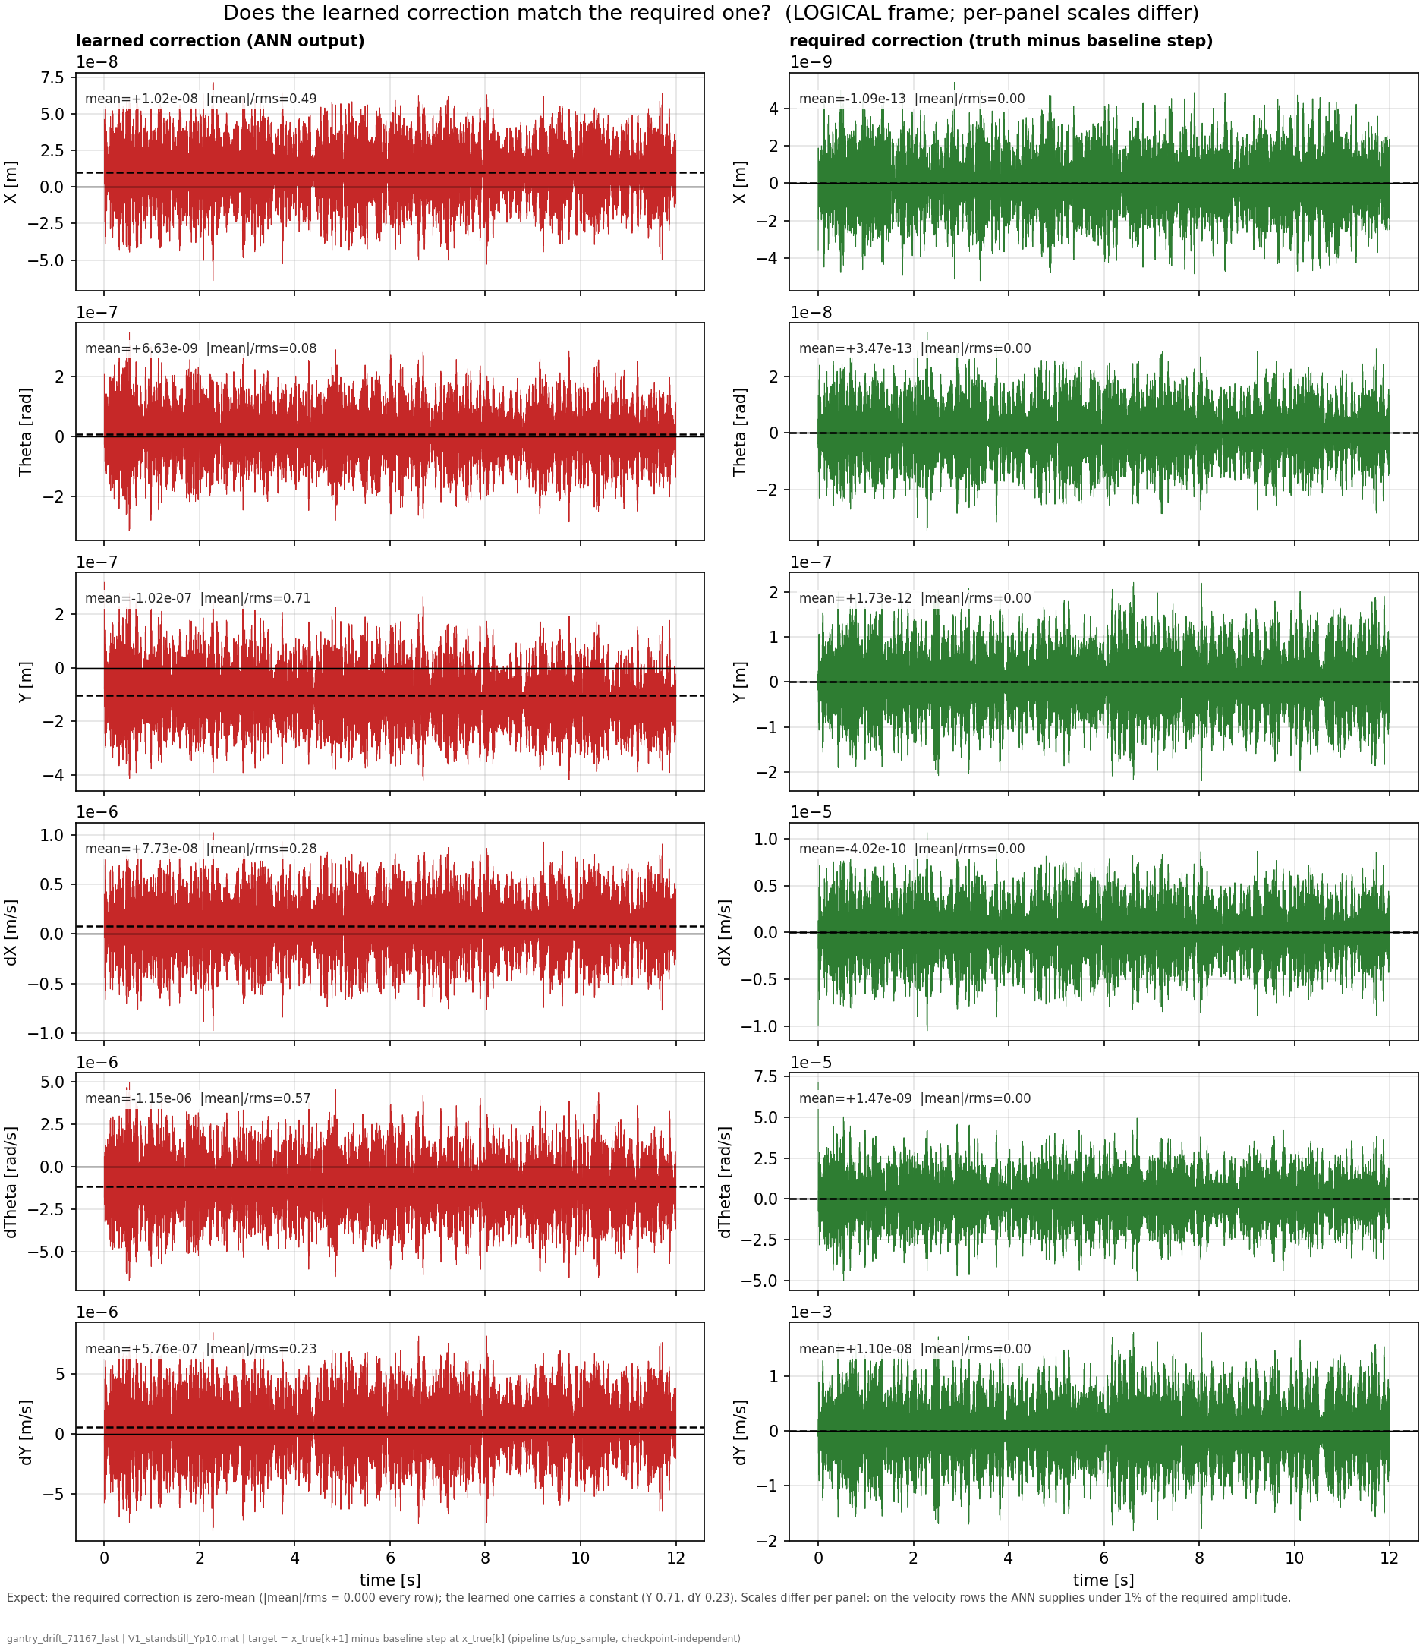
Compare against perfect correction
The correction correction for the ANN is actually zero-mean
Truth - baseline = zero-mean
Notes:
f04b (logical) and f04c (stage), side by side per state row:- Right column (green, "required correction"): what a perfect parallel block would output at every step — measured directly from the truth as x_true[k+1] − baseline step at x_true[k], checkpoint-independent. Its dashed mean lies on zero in every panel: |mean|/rms = 0.00 across all six states, both frames. Jan's zero-mean expectation, displayed as data.- Left column (red, "learned correction"): what the trained ANN actually outputs. Same layout, and the dashed means sit visibly off zero on the K=0 rows (Y at 0.71, dY at 0.23, dTheta at 0.57).- The per-panel scales carry the second finding without saying a word: on the velocity rows the required correction is at 1e-5 to 1e-3 scale while the ANN outputs 1e-6 — the network supplies under 1% of the amplitude the absorber actually demands there, the weak-signal problem quantified row by row.Bookkeeping, all done: the target arrays are saved in f04.npz (patched today, seconds of compute), the computation is permanently in generate_data.py for all three SOURCE modes (real and reuse compute it exactly; fake synthesizes a zero-mean placeholder), and the two figures are registered in make_figures.py, so everything regenerates consistently from now on.

Slide 24
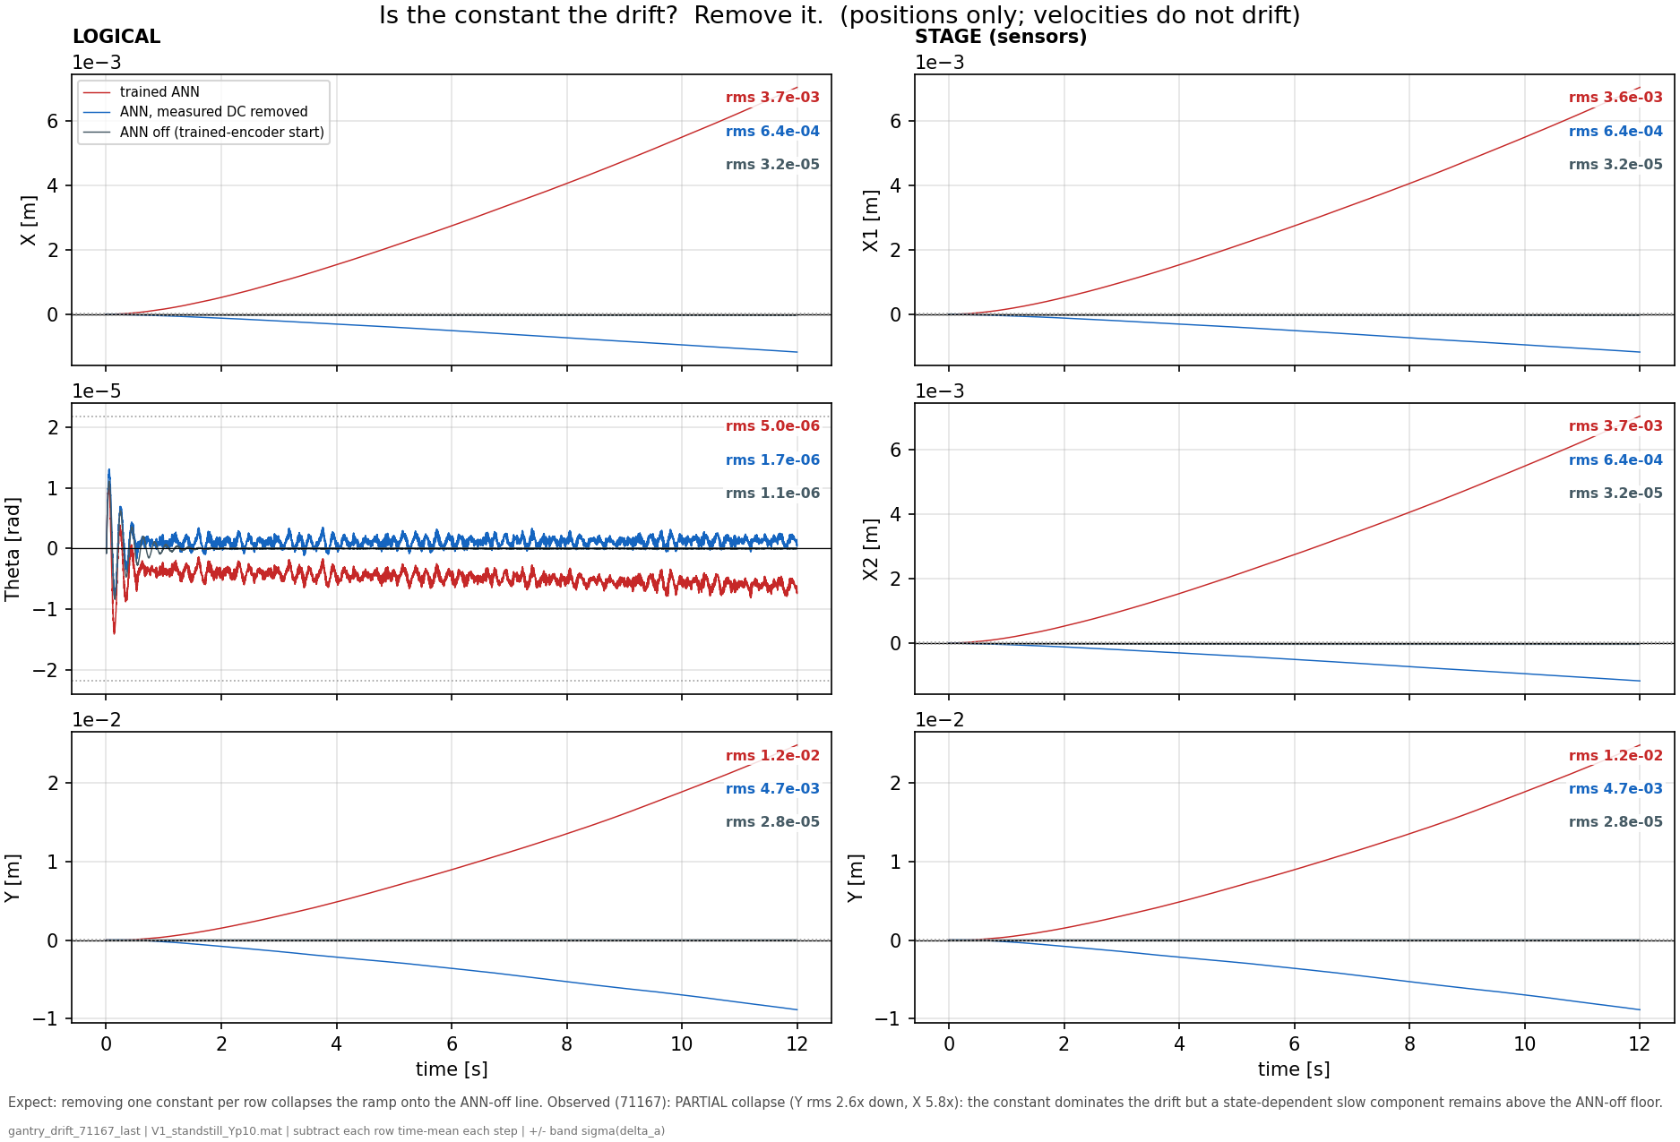
Notes:
f05 — is the constant the drift? Remove it. (full / measured-mean-subtracted / ANN off)- Shows: three re-simulations differing in one thing each: the full ANN, the same ANN with its measured per-row mean subtracted every step, and the ANN zeroed.- Hypothesis: if the constant causes the drift, subtracting one number per row collapses the ramp onto the ANN-off line.- Conclusion: the collapse is large but partial: Y rms 1.2e-2 → 4.7e-3 (2.6x), X 5.8x. The constant dominates the drift; the remainder is a slow, state-dependent offset this longer-trained checkpoint carries in addition. Causality of the mean is established by intervention, with the honest residual stated.
Pass 1 — measure it. Run the free-run with the full trained ANN and record its raw output at every step: a (T × 8) array of per-step corrections. Take the time-mean per row: one constant 8-vector, mean_w. Nothing is fitted or optimized; it is simply the average of what the ANN emitted during pass 1 (the dashed lines of f04).
Pass 2 — subtract it inside the loop. Rerun the identical free-run (same checkpoint, same encoder initial state, same input sequence), with one modification: every time the ANN is evaluated, its output is intercepted and the fixed vector is subtracted before the model uses it:$$w_{\text{used}}[k] = w_{\text{ANN}}(z[k]) - \text{mean_w}$$
Precisely, from the code: absorber_rms = data.val_x_aug[:, 0].std() — the standard deviation of the absorber's displacement δa over the V1 trajectory. That works out to ~2.19e-5 m ≈ 22 μm. It's plotted as two horizontal dotted lines at +22 μm and −22 μm (symmetric, because δa is a roughly zero-mean oscillation).What it represents: the hidden absorber (the 10%-mass MSD at 150 Hz) is exactly the unmodeled dynamics the augmentation exists to capture. Its displacement swings by ~22 μm RMS. So that band marks the scale of the thing the ANN should be learning.Why it's useful on an error plot: it turns the vertical axis into a "is this error meaningful?" yardstick:- Error inside the ±22 μm band → the residual is at absorber scale, i.e. the error is dominated by the very dynamics you're trying to model. That's the good regime.- Error outside the band → the error has grown beyond the signal itself, so it's no longer "unmodeled absorber," it's drift. On the untrained Y panel the ramp reaches ~110 μm ≈ 5× the band; on the trained figure the ANN reaches 2.6 cm ≈ 1000× the band. Both are "the error is now far bigger than the signal we care about.“
X and Y have no stiffness (K = 0). Their position is a free integrator — nothing pulls it back to a setpoint. (Physically: electric servo axes, no spring.)- Feed a constant force into such an axis: the velocity builds up to a terminal value (there's a little damping, so velocity itself stays bounded), but since that terminal velocity is nonzero and the position has no restoring stiffness, the position ramps forever. Constant force → constant drift rate → the curves you see (a short build-up, then a steady ramp to cm-scale).- Contrast with Theta (K > 0): there a constant force just produces a bounded position offset F/K — the spring balances the force and it settles. That's why Theta doesn't drift and X/Y do, under the same kind of ANN error.
So "DC-drift" = constant force × free integrator (no stiffness) = unbounded position growth. The stiffness is precisely what would stop it, and X/Y don't have it.
For your supervisor, the one-sentence version: the augmented model drifts because the ANN emits a small constant force on the stiffness-free X/Y axes, and a constant force on a free integrator integrates into unbounded position — proven by the fact that subtracting that constant removes the drift.
How it was trainedThe recipe (from the script's config):- Framework: Jan's SUBNET augmentation — the physics LPV-LFR gantry baseline in parallel with a small feedforward ANN (NX_ANN=2, 16 nodes, 2 layers, tanh) that adds corrections to the routed state rows. Encoder builds the initial state; training is windowed BPTT minimizing the nf-window simulation error with Adam.- Routing: full X+Θ+Y+absorber (0,1,2,3,4,5,6,7) — the deliverable routing, i.e. the ANN can write to the K=0 rows (that's what lets it drift).- Hyperparameters: lr = 1.49e-8, nf = 1400 (0.35 s window), 20 epochs, stride=100, validation on a cropped 8000-sample slice. Seed = cfg.seed + 3, mirroring Trial 3 of the Optuna search — the one config whose val sim-RMS actually moved past epoch 0 (6.58e-5 vs 8.01e-5), so its trained weights genuinely drift rather than staying at zero-init.- θ: nominal (joint_estimation=False) — free ANN on a correct physics baseline.- Data: the 14 noiseless augmentation simulation trajectories (standstill / ysweep / aprbs / lissajous), which contain the hidden 150 Hz MSD absorber the ANN is meant to learn.

Slide 25
Drift with ANN
ANN creates:
  DC offset force added
Shows the error
Standstill trajectory at Y = 0.1 m with multisine 130-180hz
Notes:
Precisely, from the code: absorber_rms = data.val_x_aug[:, 0].std() — the standard deviation of the absorber's displacement δa over the V1 trajectory. That works out to ~2.19e-5 m ≈ 22 μm. It's plotted as two horizontal dotted lines at +22 μm and −22 μm (symmetric, because δa is a roughly zero-mean oscillation).What it represents: the hidden absorber (the 10%-mass MSD at 150 Hz) is exactly the unmodeled dynamics the augmentation exists to capture. Its displacement swings by ~22 μm RMS. So that band marks the scale of the thing the ANN should be learning.Why it's useful on an error plot: it turns the vertical axis into a "is this error meaningful?" yardstick:- Error inside the ±22 μm band → the residual is at absorber scale, i.e. the error is dominated by the very dynamics you're trying to model. That's the good regime.- Error outside the band → the error has grown beyond the signal itself, so it's no longer "unmodeled absorber," it's drift. On the untrained Y panel the ramp reaches ~110 μm ≈ 5× the band; on the trained figure the ANN reaches 2.6 cm ≈ 1000× the band. Both are "the error is now far bigger than the signal we care about.“
X and Y have no stiffness (K = 0). Their position is a free integrator — nothing pulls it back to a setpoint. (Physically: electric servo axes, no spring.)- Feed a constant force into such an axis: the velocity builds up to a terminal value (there's a little damping, so velocity itself stays bounded), but since that terminal velocity is nonzero and the position has no restoring stiffness, the position ramps forever. Constant force → constant drift rate → the curves you see (a short build-up, then a steady ramp to cm-scale).- Contrast with Theta (K > 0): there a constant force just produces a bounded position offset F/K — the spring balances the force and it settles. That's why Theta doesn't drift and X/Y do, under the same kind of ANN error.
So "DC-drift" = constant force × free integrator (no stiffness) = unbounded position growth. The stiffness is precisely what would stop it, and X/Y don't have it.
For your supervisor, the one-sentence version: the augmented model drifts because the ANN emits a small constant force on the stiffness-free X/Y axes, and a constant force on a free integrator integrates into unbounded position — proven by the fact that subtracting that constant removes the drift.
How it was trainedThe recipe (from the script's config):- Framework: Jan's SUBNET augmentation — the physics LPV-LFR gantry baseline in parallel with a small feedforward ANN (NX_ANN=2, 16 nodes, 2 layers, tanh) that adds corrections to the routed state rows. Encoder builds the initial state; training is windowed BPTT minimizing the nf-window simulation error with Adam.- Routing: full X+Θ+Y+absorber (0,1,2,3,4,5,6,7) — the deliverable routing, i.e. the ANN can write to the K=0 rows (that's what lets it drift).- Hyperparameters: lr = 1.49e-8, nf = 1400 (0.35 s window), 20 epochs, stride=100, validation on a cropped 8000-sample slice. Seed = cfg.seed + 3, mirroring Trial 3 of the Optuna search — the one config whose val sim-RMS actually moved past epoch 0 (6.58e-5 vs 8.01e-5), so its trained weights genuinely drift rather than staying at zero-init.- θ: nominal (joint_estimation=False) — free ANN on a correct physics baseline.- Data: the 14 noiseless augmentation simulation trajectories (standstill / ysweep / aprbs / lissajous), which contain the hidden 150 Hz MSD absorber the ANN is meant to learn.

Slide 26
Drift with ANN
ANN at zero init:
  No DC offset force added
Shows the error
Standstill trajectory at Y = 0.1 m with multisine 130-180hz
Notes:
On the Y panel, look at the fine fast ripple riding on the ramp — that fast wiggle is the ~150 Hz content. It appears on Y specifically because the unmodeled absorber mass sits in the +Y direction (equilibrium offset L0 in +Y), so its mismatch imprints mainly on Y. Over 0.75 s that's ~110 cycles, so it reads as a dense ripple, not clean sinusoids.
"does removing the ANN's constant force stop the drift?" Untrained → the mean is ~0, so subtracting it changes nothing → it lies exactly on top of the red line (that overlap is the whole point of the control).
- "full ANN" (red): the free-run error using the ANN's complete output. Here (untrained) the ANN is zero-init, so this is effectively baseline + zero-ANN = the baseline free-run error.- "ANN mean removed" (blue): the counterfactual — the same free-run but with the ANN's per-row time-average (its DC/constant component) subtracted. This is the d6 test: "does removing the ANN's constant force stop the drift?" Untrained → the mean is ~0, so subtracting it changes nothing → it lies exactly on top of the red line (that overlap is the whole point of the control).- "+/- absorber RMS" (dotted horizontal lines at ±2.19e-5 m): the RMS of the absorber displacement — the scale of the signal the ANN is supposed to learn. It's a materiality yardstick: error inside the band is absorber-scale; the Y ramp climbing past it means the drift already exceeds the signal you care about.

Slide 27
    Nothing in the setup constrains that constant: the excitation does not excite it and the 0.1 s training window cannot see its free-run consequence. So the training objective is blind to the error that dominates deployment, and the augmentation is unlearnable as set up.

Slide 28
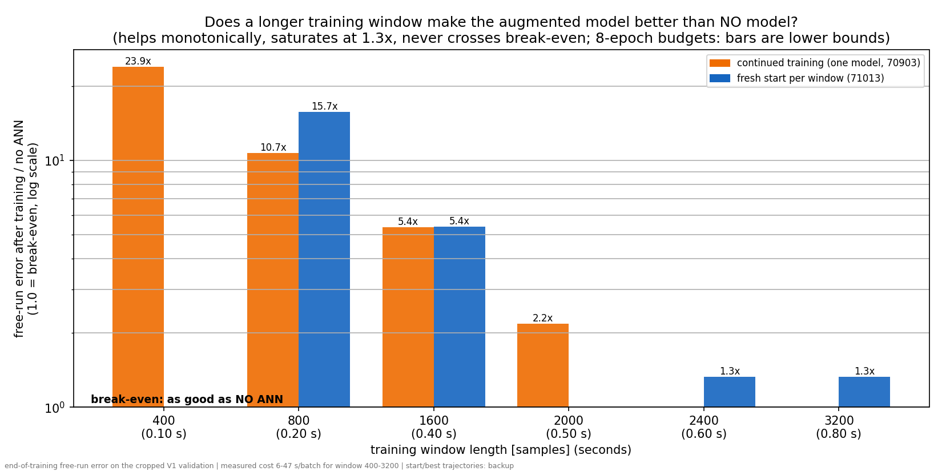
Hyperparameter search:
Learning rate and number of samples used for training (training window)
Conclusion: it is not a hyperparameter problem

Slide 29
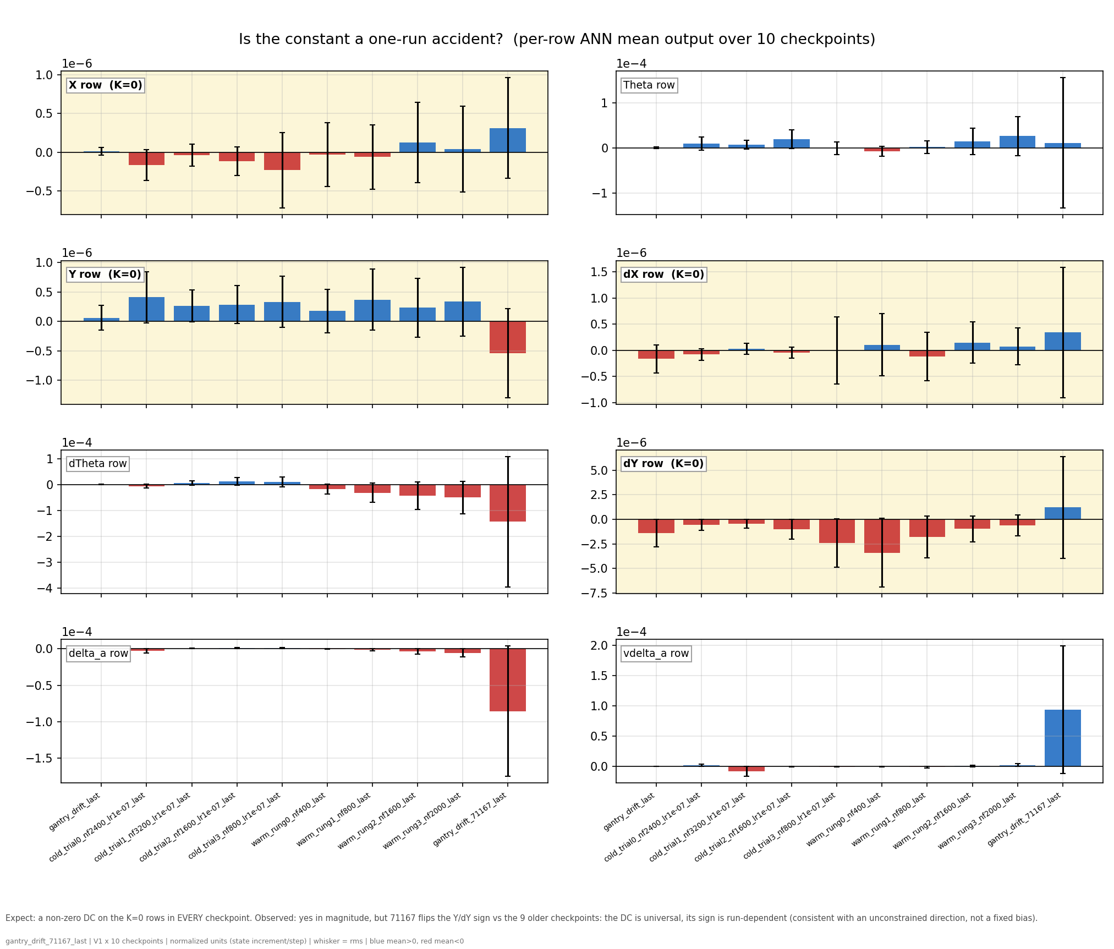
Notes:
f07 — is it a one-run accident? (per-row output mean across 10 checkpoints)- Shows: the DC (bar) and rms (whisker) of each ANN row for ten independently trained checkpoints spanning the nf and lr sweeps, cold and warm starts, plus 71167.- Hypothesis: one bad run → the other nine sit at zero; a physically demanded constant → same sign and size everywhere.- Conclusion: neither. All ten park a constant on the K=0 rows, but 71167 flips the Y/dY signs vs the other nine: universal in existence, arbitrary in value — the signature of an unconstrained direction, and direct evidence that the nf/lr tuning already performed never removed it.
f07 answers the robustness question a skeptical reader asks after f04: "you showed me one trained network with a non-zero mean — is that just one bad run?"What is plottedEight panels, one per ANN output row (X, Theta, Y, dX, dTheta, dY, and the two absorber latents), with the stiffness-free rows highlighted yellow. Within each panel there are ten bars = ten independently trained checkpoints:- the old rough drift checkpoint (gantry_drift_last),- four cold-start nf-sweep trials (nf = 800 to 3200, lr = 1e-7),- four warm-start curriculum rungs (nf = 400 to 2000),- and run 71167 (the current deck checkpoint), appended as the tenth.For each checkpoint, the ANN's output was recorded over a V1 free-run, and the bar shows the time-mean of that row's output (the DC, in normalized state-increment-per-step units); the whisker shows the rms of the same signal, i.e. the total signal size the mean should be judged against. Blue means positive mean, red negative. Bar comparable to whisker = nearly pure constant; small bar under a big whisker = a constant buried in fluctuation.How to read itTwo comparisons per panel: across bars (does every independently trained network park a constant on this row, and with what sign?) and bar vs whisker (how constant-like is each one?). Across panels: do the constants concentrate on the yellow K=0 rows?What it shows, honestly stated1. The constant is universal in existence. All ten checkpoints — different window lengths, learning-rate regimes, cold and warm starts — carry non-zero means on the K=0 rows. No amount of nf or lr tuning produced a zero-mean network, which is f07's direct contribution to the "tuning doesn't fix this" argument: the checkpoints are the tuning sweep.2. The constant is arbitrary in value and sign. This is the updated conclusion forced by 71167: the nine older checkpoints all parked a positive Y-row mean and negative dY-row mean, and 71167 flips both. The caption now says this explicitly. The sign scatter is not a weakness of the story — it is the strongest evidence for the mechanism: a constant demanded by physics would reproduce with the same sign and size in every run; a constant living in an unconstrained direction lands wherever each run's optimization noise pushes it. Ten runs, one shared property (a leftover DC), no shared value.3. 71167 is also visibly the outlier in magnitude on several rows (dTheta, delta_a, vdelta_a — largest bars and whiskers), consistent with it being the longest-trained member: more optimization steps in a flat direction means more accumulated wander.One provenance note to be transparent about in the meeting: the nine older members were measured over short (2 s) free-runs from the existing checkpoint bank, while 71167's bar is measured over the full 12 s of this generation — d15 established the DC is stationary over the run, so the horizons are comparable, but it should be said rather than discovered.Summary: f07 measures the per-row output mean of ten independently trained checkpoints spanning the nf/lr/init axes; every one of them parks a constant on the stiffness-free rows, but the sign and size differ per run (71167 flips Y/dY versus all nine older ones). Together that rules out both "one bad run" and "a fixed physical bias the ANN correctly learned," leaving exactly the deck's diagnosis: an unconstrained direction that every training run fills with its own arbitrary leftover.

Slide 30
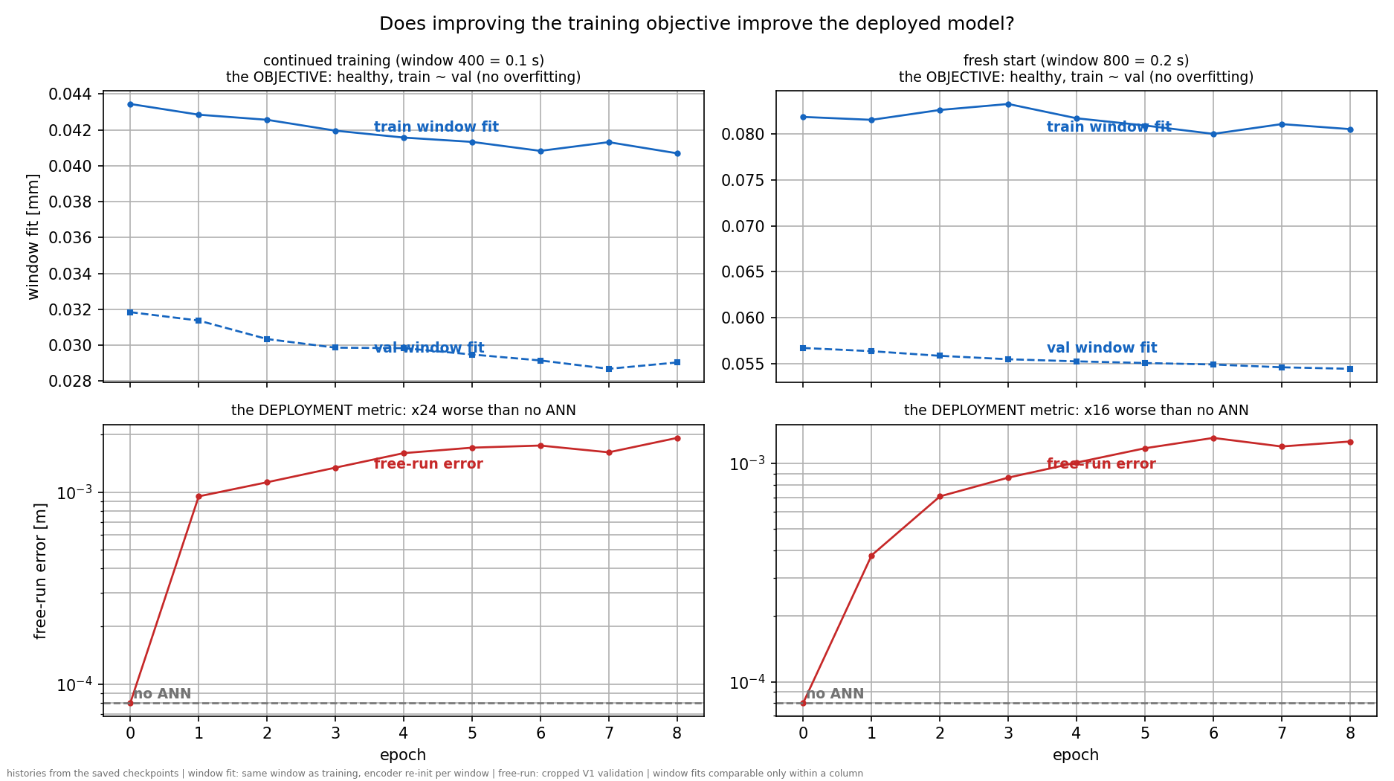
Look at train and validation loss for the training window
Why:
For validation we use sim-RMS, which is the full 12s validation open-loop free run and now 0.1 s

Slide 31
Take the derivative of the trained-ANN free-run
Position-error is the red line
Answer: is it an energy problem?

Slide 32
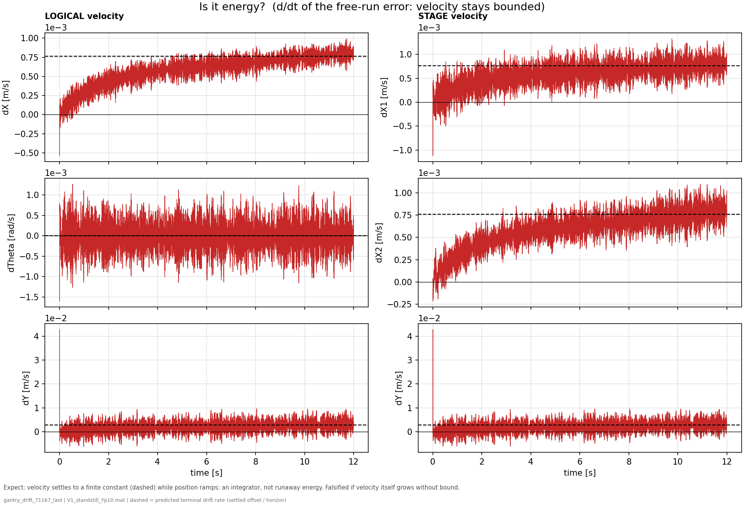
Conclusion:
Not an energy problem velocity seems to settle
Notes:
the trained-ANN free-run position error from f01 (the red drifting curves) and differentiate it in time
At t = 0 the free-run starts from the encoder's estimated state, not the true one. The estimate is good but not exact, and its velocity components are the weakest part:
f08 — is it energy? (d/dt of the drifting run's error)- Shows: the error velocity of the same trained-ANN free-run as f01, with the settled terminal rate dashed. (t = 0 spike = the encoder's initial velocity estimate error decaying with each axis's time constant — an IC transient, not drift.)- Hypothesis: if the drift were energy accumulation/instability, velocity (and kinetic energy) would grow without bound.- Conclusion: every velocity saturates at a finite terminal value while position ramps — the exact signature of a constant force balanced by damping. Energy is bounded (injection = dissipation); Jan's "no energy drift" intuition is confirmed, and an energy constraint targets nothing that is failing.

Slide 33
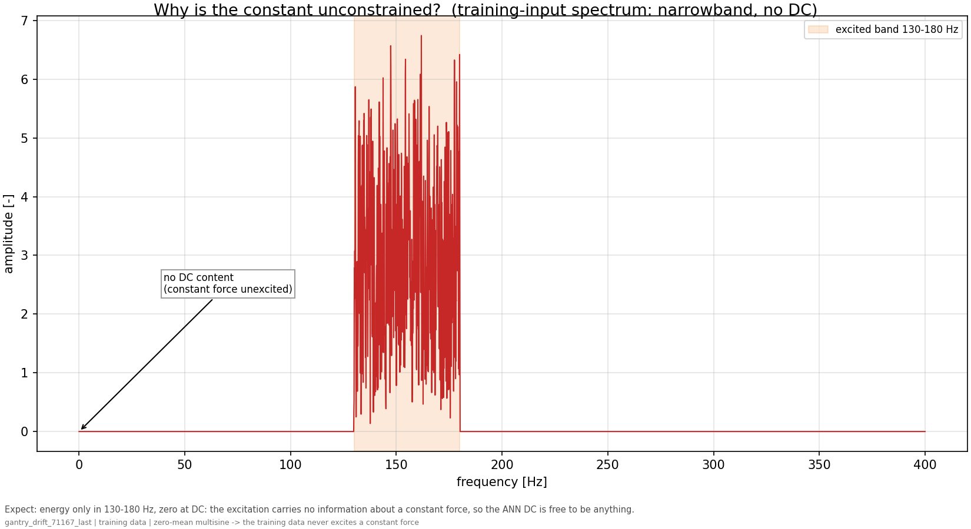
Notes:
f10 — why is the constant unconstrained? (training input spectrum)- Shows: the excitation's amplitude spectrum: energy strictly inside 130-180 Hz, exactly zero at 0 Hz.- Hypothesis: to identify a constant (a 0 Hz component), the data must contain energy at 0 Hz for the model to match or mismatch.- Conclusion: they contain none, so the correction's mean is a direction the fit never compares against anything — a free parameter. Combined with f09 (the loss can't see its consequence either), the constant is doubly unconstrained: unexcited and unpriced.

Slide 34
Solution?
Steer training so that the force added to the stiffness-free X and Y axes has no net average.
  Not a hard constraint: only discourage where the data gives no reason for one
  Problem: real system will have friction with nonzero average
    Therefore: steer only in the direction the data cannot inform

Slide 35
Configuration:
MODE: augmentation
ENCODER_INIT: linear_map
ANN_ACTIVATION: tanh
JOINT_ESTIM: False
SNR (noise): None (noiseless)
save_dir: /dataB1/dirk_van_den_berg/repos/LPV-LFR-Baseline-Augmentation/simulations/gantry_subnet/augmentation_linear_map/71167
NF_SECONDS: 0.1
na_nb (samples): 17 (4.25 ms)
Sampling rate: 4000 Hz (D=5)
Dtype: float32
Default hyperparameters (may be overridden by checkpoint):
NX_ANN: 2
n_nodes_per_layer: 16
n_hidden_layers: 2
up_sample: 1
nf: 400
na_nb: 17
batch_size: 256
lr: 1e-07
epochs: 20

Slide 36
Is the system actually zero-mean?
How is it with and without MSD
For the added mass we add an offset, does this cause the system to be non zero-mean?
For each signal take the time average

Slide 39
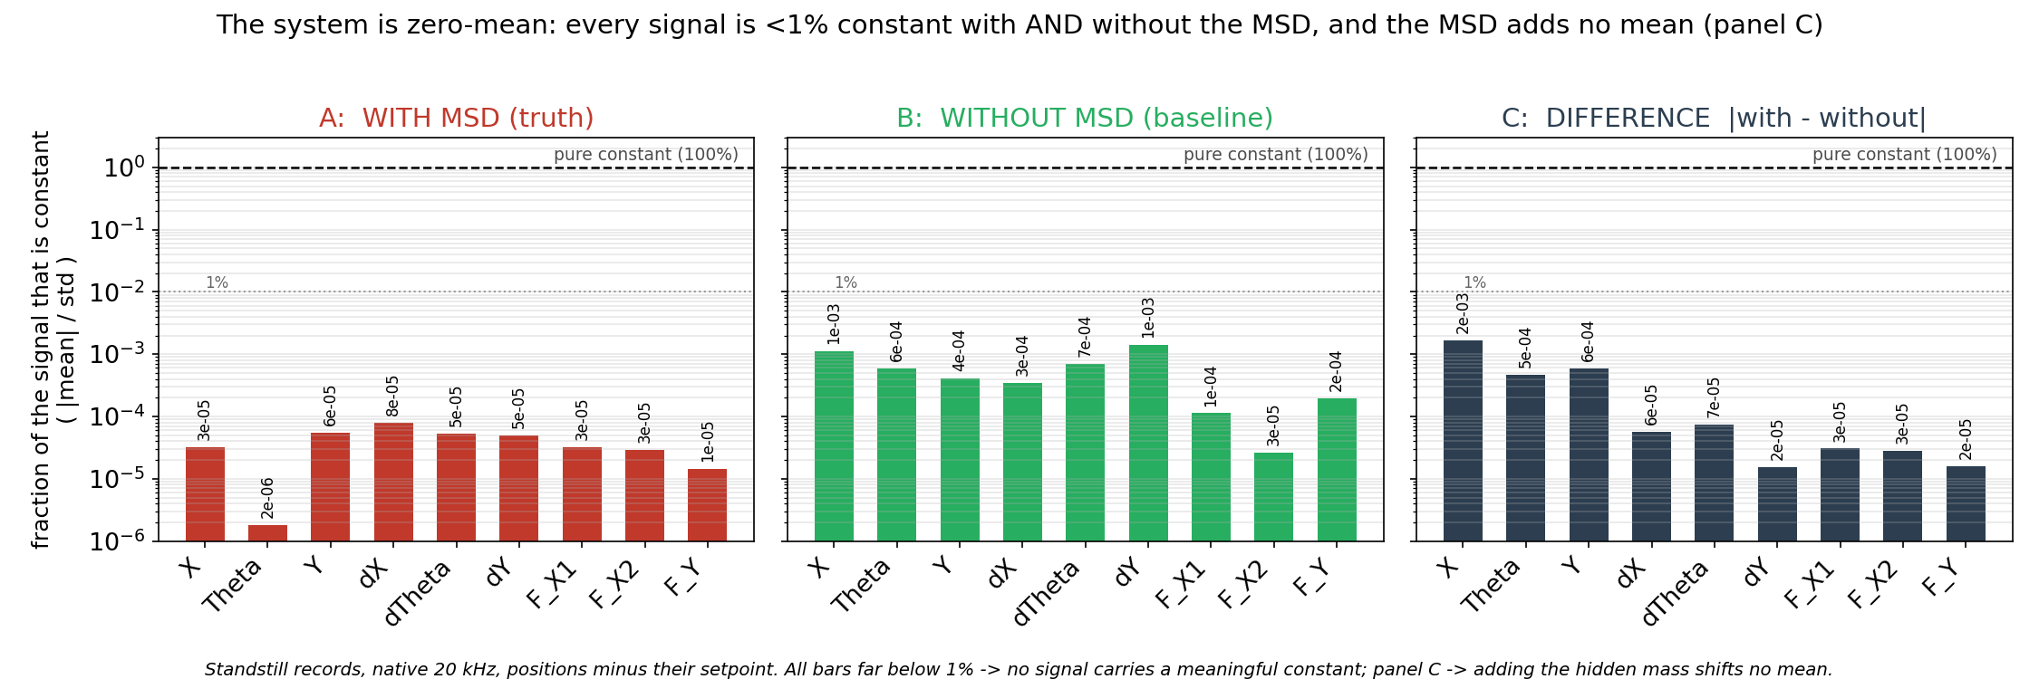
Note: minus the setpoint; NOT the signal’s own time-mean
Standstill operating points: T1_standstill_Ym30, T2_standstill_Ym15, T3_standstill_Y000, T4_standstill_Yp15, T5_standstill_Yp30
Notes:
T1_standstill_Ym30, T2_standstill_Ym15, T3_standstill_Y000, T4_standstill_Yp15, T5_standstill_Yp30

Slide 40
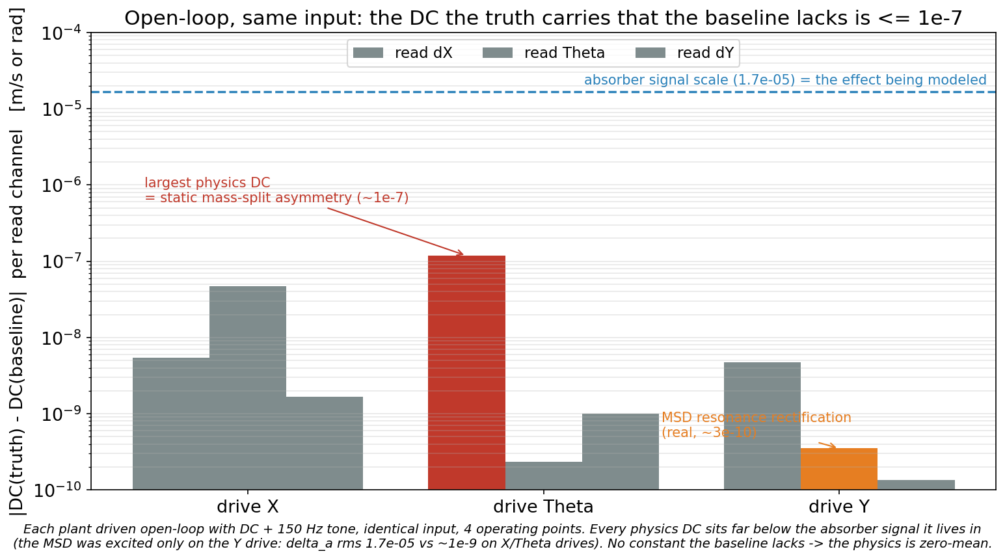
Does the controller compensate/mask the zero mean issue?
Notes:
fig0b (v1f): uses a synthesized input (a DC offset + a 150 Hz tone) that the script generates itself and feeds straight into the plant EOMs. It never loads a T-record.
The only overlap is the operating points: v1f sweeps Y₀ = {−0.30, 0, +0.10, +0.30} m, which partially coincide with the standstill setpoints (−0.30, 0, +0.30 = T1/T3/T5; the +0.10 is the V1 validation operating point, not a standstill record). But that's just where it sets the initial Y — the input signal is entirely different (a designed excitation, not the recorded multisine).
Bottom line: fig0 = T1–T5 recorded standstill data; fig0b = a separate open-loop simulation with a designed DC+tone input at overlapping operating points. Only the Y operating points overlap; the data and method are otherwise completely different.

Slide 41
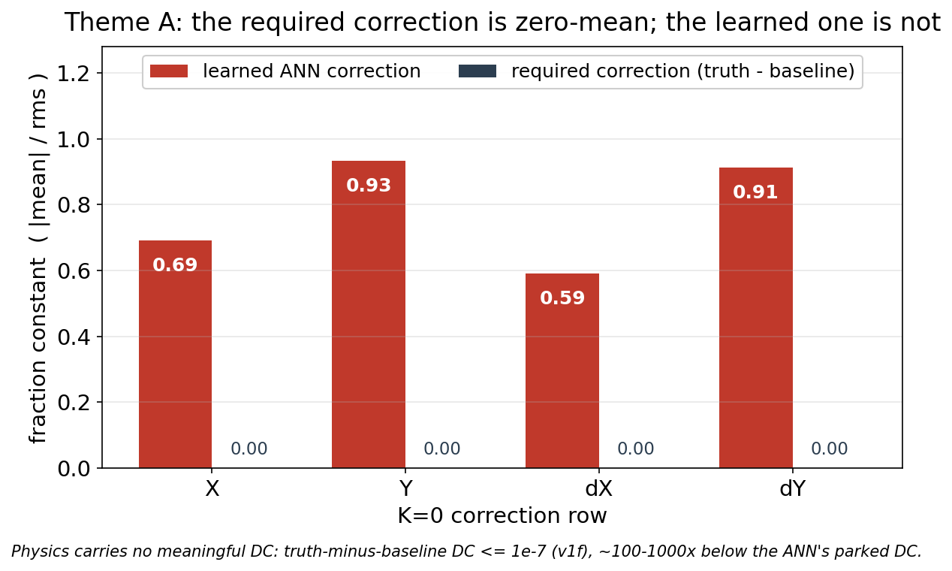
Required correction is zero-mean
For optimal augmentation

Slide 42
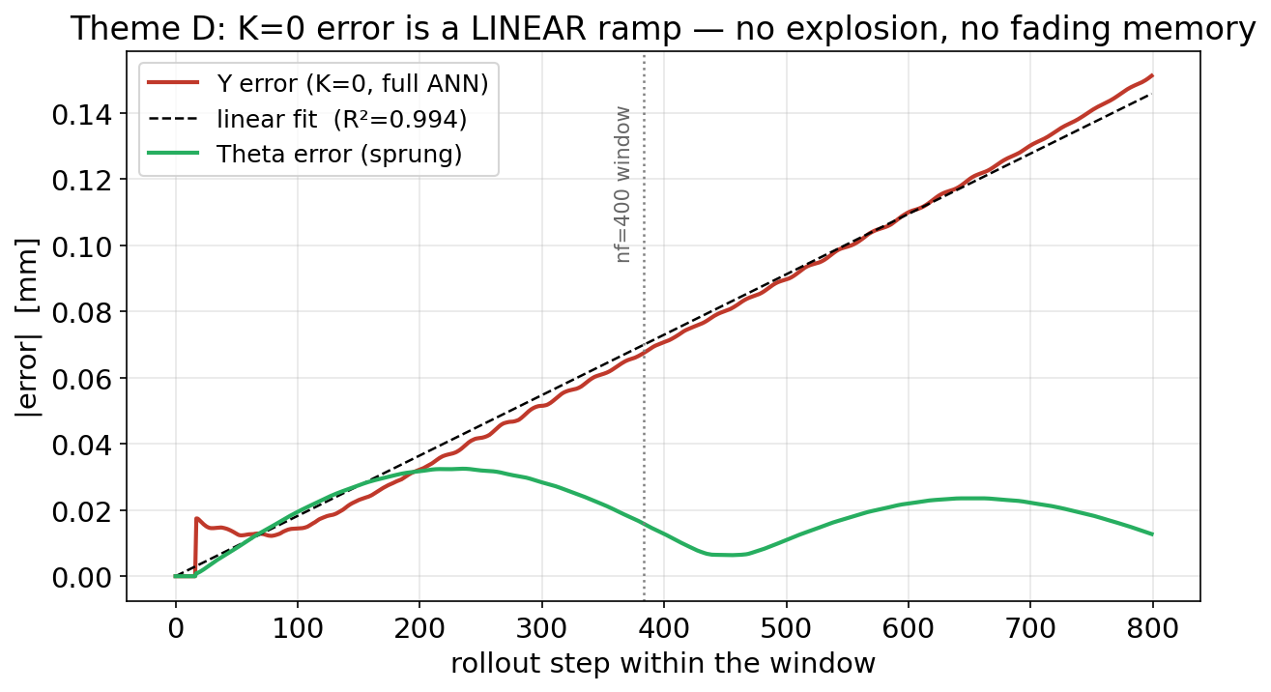
Error is linear
Within the window the Y (K=0) error is a linear ramp (R²=0.994); no explosion
Theta (sprung) parks. (No fading memory is K=0-specific.)
Notes:
- x-axis: rollout step within one free-run window (0 → 800 steps).- y-axis: the free-run prediction error (|error| vs. the truth), averaged over 60 windows.- Red curve — Y error (a K=0 axis, full ANN): grows as a straight linear ramp.- Dashed black — a linear fit (R² = 0.994): confirms the Y error really is linear, not curved.- Green curve — Θ error (the sprung axis): oscillates and stays bounded — it does not ramp.- Dotted vertical line: the nf = 400 training-window boundary.

Slide 43
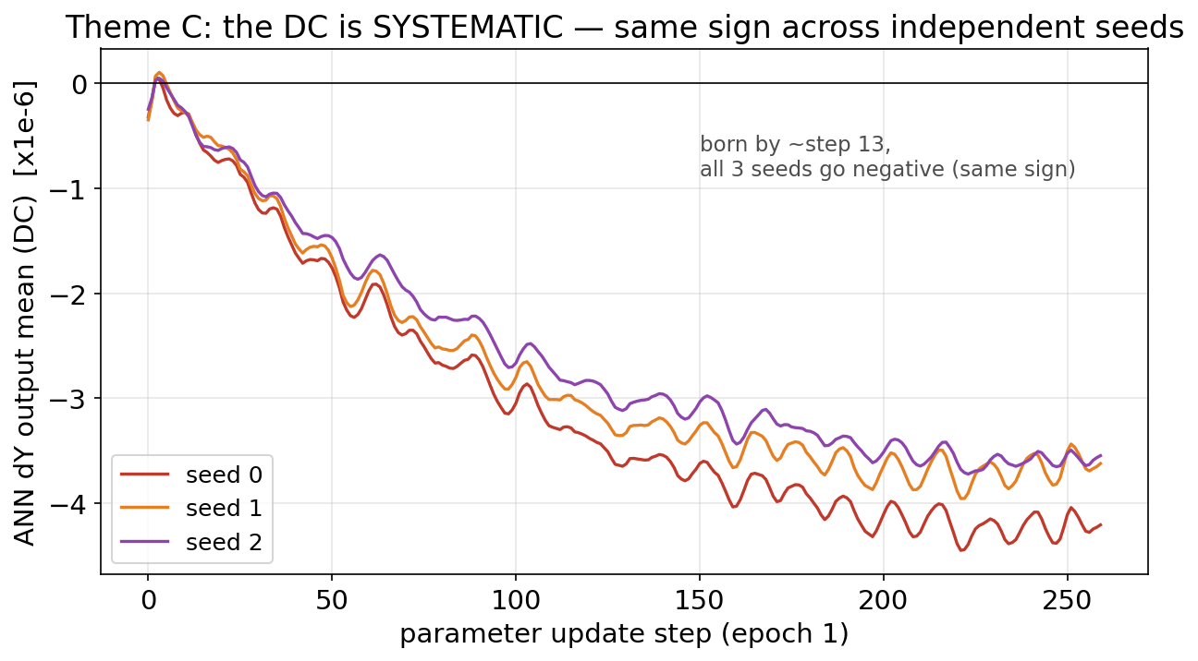
DC is systematic
Different seeds

Slide 44
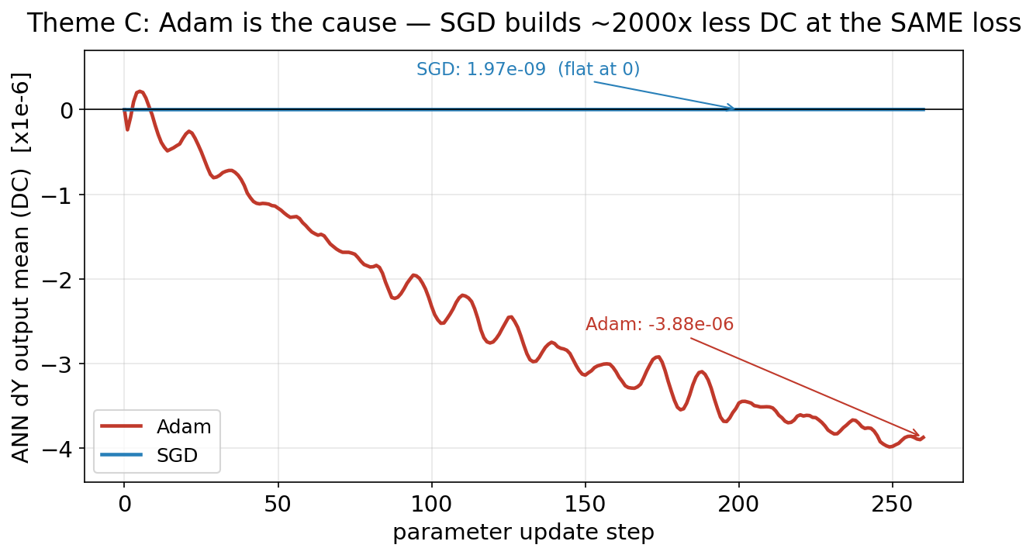
Optimizer
Adam vs SGD
Everything is held fixed, only changed the optimizer
Same training loss
ANN correction: Shows the mean of the output of dY and for adam it clearly becomes non-zero
Notes:
both ≈ 1.5–2e-6, both clearly training — SGD not stalled), not literally identical — SGD's was slightly higher. The point still holds because the DC differs ~2000×,
Same 14 trajectories training data
1. SGD underfits this problem. The augmentation objective is badly-scaled / block-heterogeneous (positions, velocities, latent states on very different scales; physics + ANN). Adam's per-parameter adaptivity is exactly what handles that — a single global SGD learning rate cannot (Zhang et al. 2024, "Why Transformers Need Adam"). Trained to convergence, SGD would give a worse augmentation, not a good DC-free one.2. Its low DC is a symptom, not a cure. SGD builds less DC because it takes a vanishing step in the flat direction — the very same reason it stalls in ill-conditioned directions. You'd trade the DC for poor convergence.3. Figure 4 is a short, low-loss probe. "Same loss" was matched in a short probe where neither optimizer has learned much of the real dynamics. It says nothing about held-out free-run quality (BFR) — we never validated that SGD produces a good model.4. The DC isn't even the main problem (fig 5). The dominant drift is the ANN's dynamic output destabilizing the marginal Y axis, not the DC. SGD-vs-Adam only concerns the DC (a smaller, X-axis effect) — so even a DC-free SGD wouldn't fix the dominant divergence.Its role in the storyFigure 4 does one job: it localizes the cause (Adam's implicit bias → the non-zero mean is estimator/optimizer-side, not physical), which supports Theme A/C — the system is zero-mean, the DC is an artifact. The fix is structural (a zero-mean constraint, or the stability-preserving augmentation route), keeping Adam's conditioning benefits. Switching to SGD would swap a targeted, fixable artifact for a globally worse fit.

Slide 45
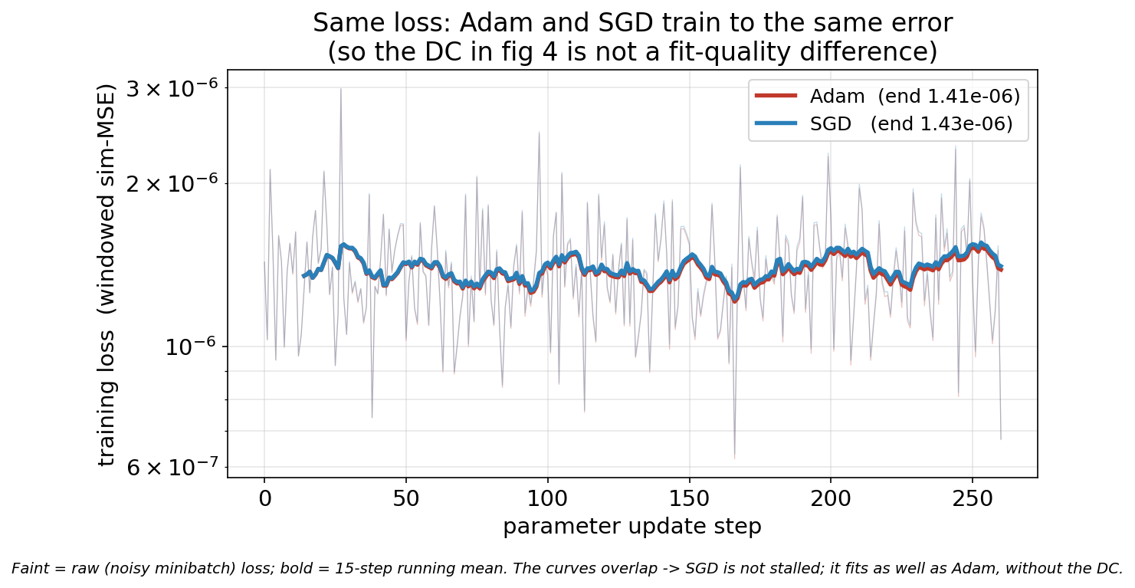
Notes:
That faint, jagged background is the raw per-step training loss — I plotted it lightly (alpha ~0.3) behind the bold smoothed curves. It's not an artifact or a problem; it's normal minibatch noise:- Each update step computes the loss on a different random minibatch (256 windows out of ~66k). So the measured loss jumps around step-to-step depending on which windows happen to be in that batch — anywhere from ~6e-7 to ~3e-6.- That step-to-step scatter is the expected fluctuation of stochastic (minibatch) training. It's the same for both optimizers, which is why it looks like one gray band (the Adam-raw and SGD-raw curves overlap).- The bold lines are the 15-step running mean — the underlying trend, which is what you read for "same loss." Both trends sit at ~1.4e-6 and overlap.So: faint = the real noisy loss; bold = its smoothed trend. I included the raw on purpose so the figure shows the actual measured loss (not a suspiciously-clean line), and so you can see both optimizers share the same noise envelope.If it reads as clutter for the meeting, I can either (a) drop the raw and show only the two smoothed curves (cleanest), or (b) lighten it further. I'd lean toward keeping a faint version — a reviewer trusts a noisy-but-overlapping loss more than two perfectly smooth lines. Want me to declutter it, or leave it as is?

Slide 46
Why not just replace Adam with SGD?
SGD is not the proper fit for the problem:
  SGD underfits this problem: the augmentation objective is badly-scaled (positions, velocities, latent states on very different scales; physics + ANN).
    Adam's per-parameter adaptivity is exactly what handles that
    a single global SGD learning rate cannot, SGD would have worse convergence /augmentation
Look into other per parameter optimizers?
Notes:
SGD is not the proper fit for the problem:
1. SGD underfits this problem. The augmentation objective is badly-scaled / block-heterogeneous (positions, velocities, latent states on very different scales; physics + ANN). Adam's per-parameter adaptivity is exactly what handles that — a single global SGD learning rate cannot (Zhang et al. 2024, "Why Transformers Need Adam"). Trained to convergence, SGD would give a worse augmentation, not a good DC-free one.

Slide 47
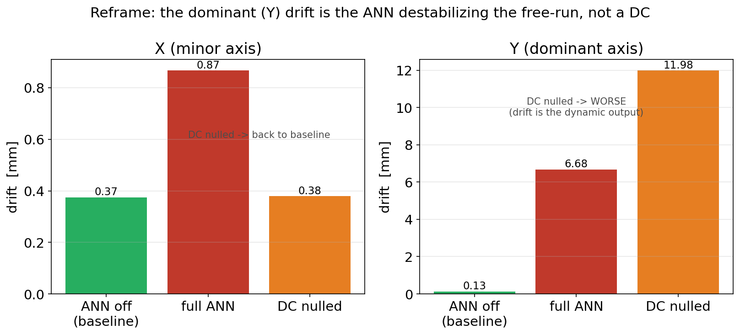
Nulling the DC brings X back to baseline but makes Y worse
The dominant drift is the ANN destabilizing, not a DC.
Notes:
In figure 5, "DC nulled" is a counterfactual: it's the same trained ANN, but with its constant (DC) output on the K=0 rows subtracted out, keeping everything else.
What each of the three bars isFor a given axis (X or Y), the drift of the long free-run under three conditions:- ANN off (baseline): the physics baseline alone, no correction.- full ANN: the trained ANN as-is (its correction = a constant part + a state-dependent "dynamic" part).- DC nulled: take that same trained ANN and remove only the constant part of its output on the K=0 rows — i.e. subtract its measured time-mean — leaving just the dynamic (state-dependent) part.
how do we get the DC nulled data?:
The "DC nulled" data comes from the v5 diagnostic (v5_dc_null_counterfactual.py), and it's computed post-hoc, not retrained. Three steps on the trained (drifted) checkpoint:The "DC nulled" data comes from the v5 diagnostic (v5_dc_null_counterfactual.py), and it's computed post-hoc, not retrained. Three steps on the trained (drifted) checkpoint:1. Start from the trained modelLoad the drifted checkpoint gantry_drift_71167_last.pth — the ANN that already learned the DC.2. Measure the DCRun the model in free-run once, capture the ANN's output at every step, and take the per-row time-mean — that's the constant (DC) part of its correction. Keep only the K=0 rows {X, Y, dX, dY} → this gives the DC vector dc_vec (e.g. dY ≈ −8.8e-6). Theta and the absorber rows are left untouched.3. Re-run the free-run, subtracting that constantFree-run again, but now the ANN's output at each step is ANN(x) − α·dc_vec. Implemented by monkey-patching ann.forward (a "shadow" wrapper) so it returns the normal output minus the constant — same mechanism v4 used for its DC-muted pass. Then measure the drift (tail-RMS position error over 8000 steps, on 3 standstill records).The α knob sweeps the removal:- α = 0 → subtract nothing → full ANN (the "full ANN" bar).- α = 1 → subtract the entire measured DC → "DC nulled" bar.- (v5 actually ran α = 0, 0.25, 0.5, 0.75, 1.0; fig5 shows the two endpoints.)Key properties- No retraining. We take the fixed trained weights and just subtract a constant from the output during the rollout. The dynamic (state-dependent) part of the ANN is untouched — only the constant is removed.- The DC is the model's own measured mean, not an external number — so "DC nulled" is literally "this ANN, minus the average of what it outputs on the K=0 rows."- Same free-run setup as the other bars (same records, same 8000-step horizon), so the three bars are directly comparable.Bottom line: we free-run the trained ANN once to measure its constant output on the K=0 rows, then free-run again subtracting that constant (α=1) — no retraining. That's the "DC nulled" trajectory, and its drift is the third bar. The caveat from before still holds: it's a surgical edit of the trained model, not a model retrained to have zero DC.

Slide 48
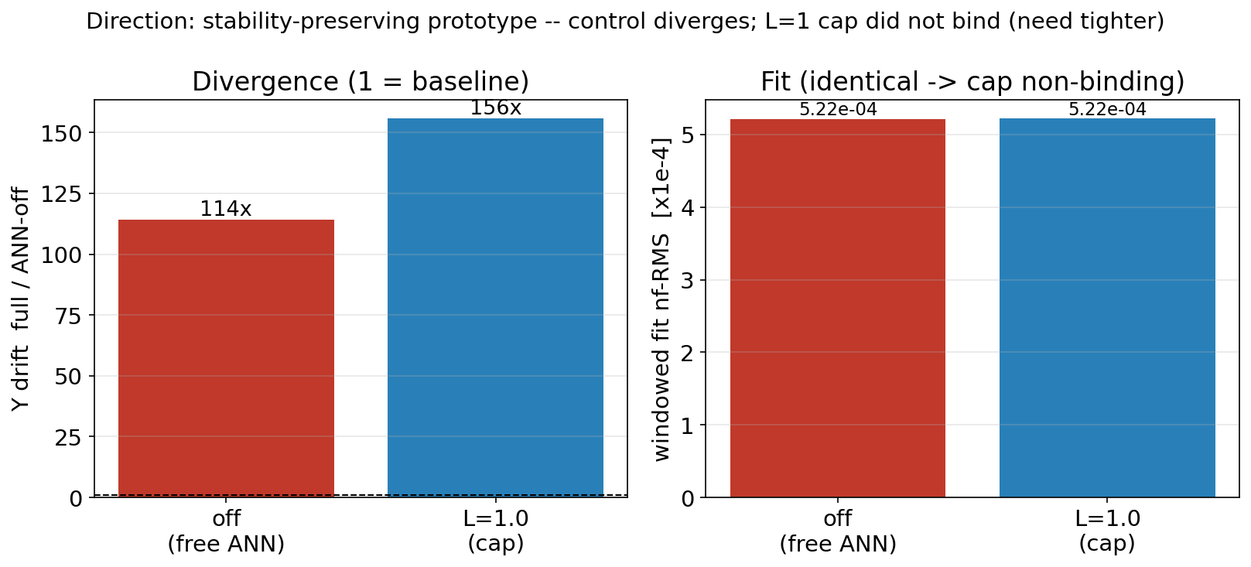
Control diverges (114×); the L=1 cap was non-binding (fit identical) → stability-preserving prototype, tighter sweep next.

Slide 49
Potential solution
DC-pin
The DC-pin adds a penalty to the training loss that punishes the ANN for having a non-zero average output on the drift-prone (K=0) rows
  So the optimizer is forced to keep that correction zero-mean instead of drifting into a constant.

Slide 50
What it computes soft penalty
At each training step:
Evaluate the ANN across the operating range (a fixed set of points spanning the data).
Take the mean of its output on the K=0 rows. That mean is the DC (the constant).
Square it, weight by β, and add it to the loss:
V_pin = β · Σ_{K=0 rows} ( mean output on that row )²
Backprop then pushes that mean toward zero, every step.
Notes:
Evaluate the ANN at the fixed point set: ann(Z_pts) → a big table, ~6,718 points × 8 output rows. (Each row of the table is the ANN's correction at one operating point.)
2. For each K=0 row, average down the column: e.g. for the dY row, take all 6,718 dY-outputs and average them → one number = the dY DC. (For Adam that came out ≈ −8.8e-6; the pin's job is to make it ~0.)
3. Square that number, sum over the K=0 rows, weight by β:V_pin = β · [ (mean X)² + (mean Y)² + (mean dX)² + (mean dY)² ]4. Add V_pin to the loss → backprop pushes each of those four means toward zero.
soft/penalty form of "project out the known flat direction"
The DC lives in a loss-flat direction — the fit barely cares about it — which is exactly why Adam drifts into it (nothing pushes back). The pin adds a gradient specifically in that direction — a restoring force — that opposes the drift. So instead of walking off into the constant, the ANN gets pulled back to zero-mean. It's targeted: the spring acts only on the constant direction, so it doesn't fight the useful (dynamic) learning.
Why it works (the key idea)The DC lives in a loss-flat direction — the fit barely cares about it — which is exactly why Adam drifts into it (nothing pushes back). The pin adds a gradient specifically in that direction — a restoring force — that opposes the drift. So instead of walking off into the constant, the ANN gets pulled back to zero-mean. It's targeted: the spring acts only on the constant direction, so it doesn't fight the useful (dynamic) learning.What it deliberately does not do (important for R2)- It pins only the constant (mean) — the ANN stays free to represent everything else (no hard class restriction → full expressivity, R2).- It acts only on the K=0 rows (the marginally-stable axes where a constant integrates into drift).- It's soft (a penalty, tunable by β) — drives the DC very small, not exactly zero.Where it sits in the literature (if Jan asks)

Slide 51
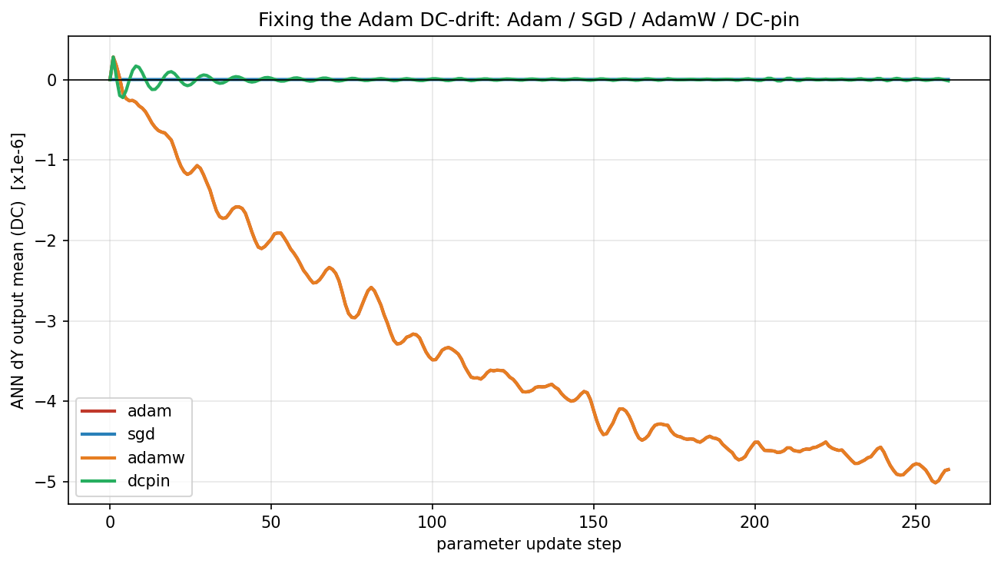

Slide 52
Optimizer | DC dY (tail) | DC dX (tail)
adam | -4.87e-6 | +1.003e-07
adamw | -4.868e-6 | +1.003e-07
sgd | +1.8e-9 | -2.700e-09
dcpin | +2.2e-11 | +2.192e-09
Notes:
=== SUMMARY (tail-20) ===
adam : DC dY=-4.868e-06 | DC dX=+1.003e-07 | loss=1.395e-06
sgd : DC dY=+1.835e-09 | DC dX=-2.700e-09 | loss=1.427e-06
adamw : DC dY=-4.868e-06 | DC dX=+1.003e-07 | loss=1.395e-06
dcpin : DC dY=+2.237e-11 | DC dX=+2.192e-09 | loss=1.394e-06

Slide 53
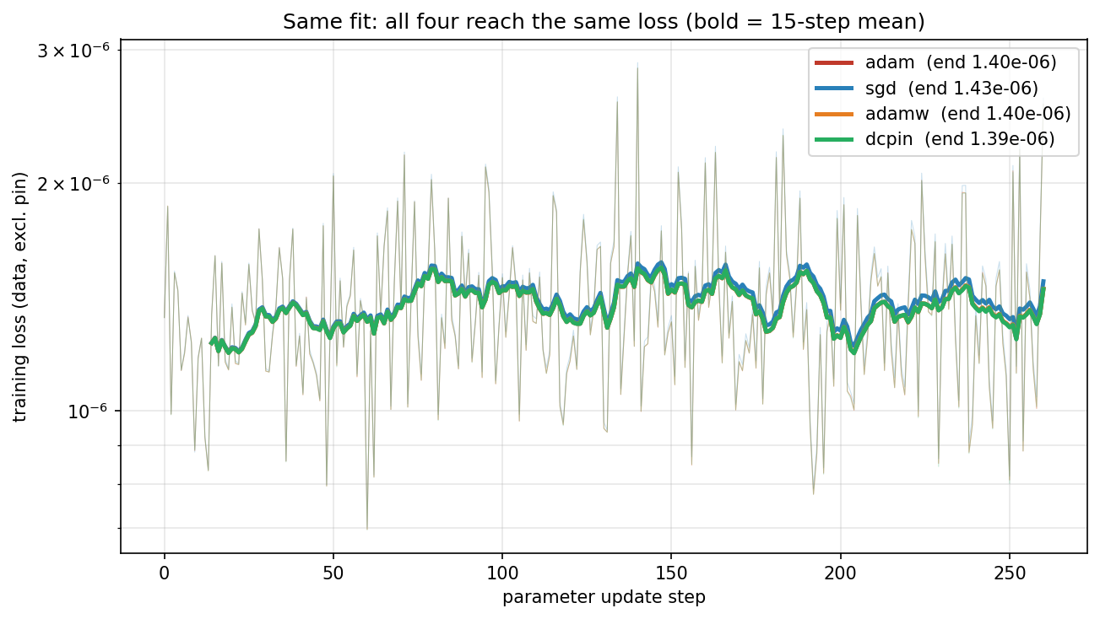

Slide 54
Potential issue
This figure does not show the long free-run Y drift.
Output-mean = 0 is not the same quantity as position-drift = 0
Previous figure already showed the dominant Y drift is the ANN's dynamic (state-dependent) output, not the constant
  Nulling the DC actually made Y worse.

Slide 55
Nulling the DC brings X back to baseline but makes Y worse
The dominant drift is the ANN destabilizing, not a DC.
Notes:
In figure 5, "DC nulled" is a counterfactual: it's the same trained ANN, but with its constant (DC) output on the K=0 rows subtracted out, keeping everything else.
What each of the three bars isFor a given axis (X or Y), the drift of the long free-run under three conditions:- ANN off (baseline): the physics baseline alone, no correction.- full ANN: the trained ANN as-is (its correction = a constant part + a state-dependent "dynamic" part).- DC nulled: take that same trained ANN and remove only the constant part of its output on the K=0 rows — i.e. subtract its measured time-mean — leaving just the dynamic (state-dependent) part.
how do we get the DC nulled data?:
The "DC nulled" data comes from the v5 diagnostic (v5_dc_null_counterfactual.py), and it's computed post-hoc, not retrained. Three steps on the trained (drifted) checkpoint:The "DC nulled" data comes from the v5 diagnostic (v5_dc_null_counterfactual.py), and it's computed post-hoc, not retrained. Three steps on the trained (drifted) checkpoint:1. Start from the trained modelLoad the drifted checkpoint gantry_drift_71167_last.pth — the ANN that already learned the DC.2. Measure the DCRun the model in free-run once, capture the ANN's output at every step, and take the per-row time-mean — that's the constant (DC) part of its correction. Keep only the K=0 rows {X, Y, dX, dY} → this gives the DC vector dc_vec (e.g. dY ≈ −8.8e-6). Theta and the absorber rows are left untouched.3. Re-run the free-run, subtracting that constantFree-run again, but now the ANN's output at each step is ANN(x) − α·dc_vec. Implemented by monkey-patching ann.forward (a "shadow" wrapper) so it returns the normal output minus the constant — same mechanism v4 used for its DC-muted pass. Then measure the drift (tail-RMS position error over 8000 steps, on 3 standstill records).The α knob sweeps the removal:- α = 0 → subtract nothing → full ANN (the "full ANN" bar).- α = 1 → subtract the entire measured DC → "DC nulled" bar.- (v5 actually ran α = 0, 0.25, 0.5, 0.75, 1.0; fig5 shows the two endpoints.)Key properties- No retraining. We take the fixed trained weights and just subtract a constant from the output during the rollout. The dynamic (state-dependent) part of the ANN is untouched — only the constant is removed.- The DC is the model's own measured mean, not an external number — so "DC nulled" is literally "this ANN, minus the average of what it outputs on the K=0 rows."- Same free-run setup as the other bars (same records, same 8000-step horizon), so the three bars are directly comparable.Bottom line: we free-run the trained ANN once to measure its constant output on the K=0 rows, then free-run again subtracting that constant (α=1) — no retraining. That's the "DC nulled" trajectory, and its drift is the third bar. The caveat from before still holds: it's a surgical edit of the trained model, not a model retrained to have zero DC.

Slide 56
Nulling the DC brings X back to baseline but makes Y worse
The dominant drift is the ANN destabilizing, not a DC.
In our LPV-LFR model Y is being scheduled. This error propagates.
Short window loss is blind to long-horizon stability
  Potentially with DC-pin longer horizons can fix this?
Notes:
In figure 5, "DC nulled" is a counterfactual: it's the same trained ANN, but with its constant (DC) output on the K=0 rows subtracted out, keeping everything else.
What each of the three bars isFor a given axis (X or Y), the drift of the long free-run under three conditions:- ANN off (baseline): the physics baseline alone, no correction.- full ANN: the trained ANN as-is (its correction = a constant part + a state-dependent "dynamic" part).- DC nulled: take that same trained ANN and remove only the constant part of its output on the K=0 rows — i.e. subtract its measured time-mean — leaving just the dynamic (state-dependent) part.
how do we get the DC nulled data?:
The "DC nulled" data comes from the v5 diagnostic (v5_dc_null_counterfactual.py), and it's computed post-hoc, not retrained. Three steps on the trained (drifted) checkpoint:The "DC nulled" data comes from the v5 diagnostic (v5_dc_null_counterfactual.py), and it's computed post-hoc, not retrained. Three steps on the trained (drifted) checkpoint:1. Start from the trained modelLoad the drifted checkpoint gantry_drift_71167_last.pth — the ANN that already learned the DC.2. Measure the DCRun the model in free-run once, capture the ANN's output at every step, and take the per-row time-mean — that's the constant (DC) part of its correction. Keep only the K=0 rows {X, Y, dX, dY} → this gives the DC vector dc_vec (e.g. dY ≈ −8.8e-6). Theta and the absorber rows are left untouched.3. Re-run the free-run, subtracting that constantFree-run again, but now the ANN's output at each step is ANN(x) − α·dc_vec. Implemented by monkey-patching ann.forward (a "shadow" wrapper) so it returns the normal output minus the constant — same mechanism v4 used for its DC-muted pass. Then measure the drift (tail-RMS position error over 8000 steps, on 3 standstill records).The α knob sweeps the removal:- α = 0 → subtract nothing → full ANN (the "full ANN" bar).- α = 1 → subtract the entire measured DC → "DC nulled" bar.- (v5 actually ran α = 0, 0.25, 0.5, 0.75, 1.0; fig5 shows the two endpoints.)Key properties- No retraining. We take the fixed trained weights and just subtract a constant from the output during the rollout. The dynamic (state-dependent) part of the ANN is untouched — only the constant is removed.- The DC is the model's own measured mean, not an external number — so "DC nulled" is literally "this ANN, minus the average of what it outputs on the K=0 rows."- Same free-run setup as the other bars (same records, same 8000-step horizon), so the three bars are directly comparable.Bottom line: we free-run the trained ANN once to measure its constant output on the K=0 rows, then free-run again subtracting that constant (α=1) — no retraining. That's the "DC nulled" trajectory, and its drift is the third bar. The caveat from before still holds: it's a surgical edit of the trained model, not a model retrained to have zero DC.

Slide 57
Outline next week
Need to fix the optimizer issue before I can proceed with anything else
  Rest of the training such as orthogonality depends on the ANN properly working.

Slide 58
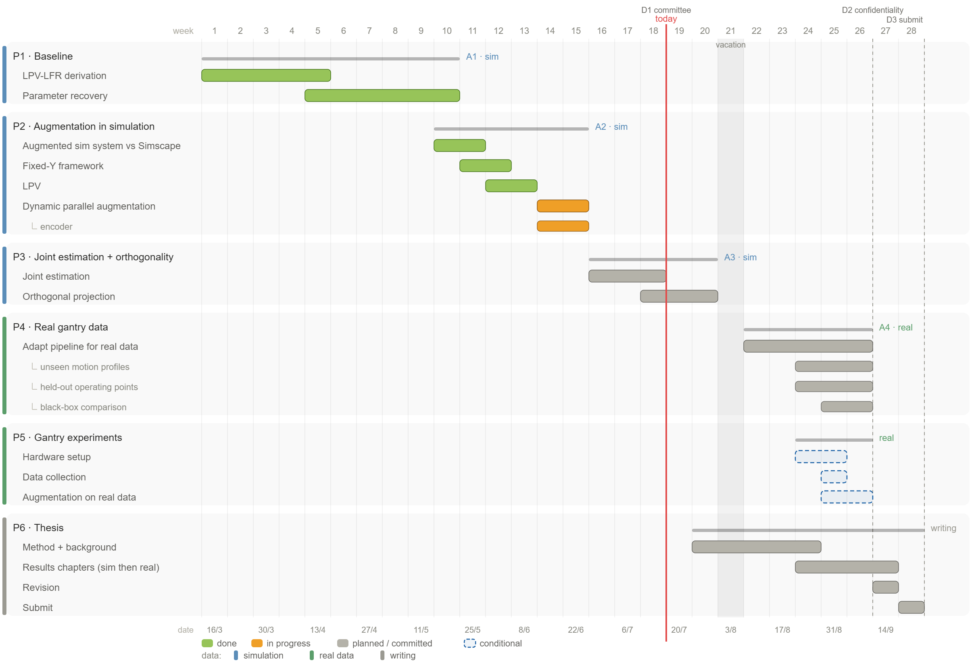

Slide 60
New slides 2.0

Slide 61
Where the phantom gradient comes from (zero-mean residual, nonzero gradient)
Where the phantom gradient comes from (zero-mean residual, nonzero gradient)The subtle part you are implicitly asking: if the true residual is zero-mean (demands DC = 0), how does a nonzero gradient on the DC arise at all? It does not come from a DC in the data. It comes from truncating the BPTT rollout at nf on a z=1 axis: the gradient computed over a 0.1 s window systematically mis-weights the long-horizon sensitivity that a marginal mode carries, so even a zero-mean AC residual, pushed through the truncated integrating rollout, produces a small net gradient on the constant. This is the known bias of truncated backpropagation through time (Tallec & Ollivier, "Unbiasing Truncated Backpropagation Through Time", arXiv:1705.08209 (https://arxiv.org/abs/1705.08209)), and its fingerprint here is unmistakable: the DC scales as 1.7e-3/nf. A genuine data DC would be nf-independent; a truncation artifact scales as 1/nf, which is what we measure.
truncating the BPTT rollout at nf on a z=1 axis

Slide 62
Optimizer | DC dY (tail)
adam | −4.87e-6
adamw | −4.868e-6
sgd | +1.8e-9
dcpin | +2.2e-11

Slide 64
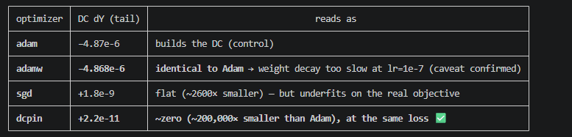
│ optimizer │ DC dY (tail) │ reads as │├───────────┼──────────────┼─────────────────────────────────────────────────────────────────────────┤│ adam │ −4.87e-6 │ builds the DC (control) │├───────────┼──────────────┼─────────────────────────────────────────────────────────────────────────┤│ adamw │ −4.868e-6 │ identical to Adam → weight decay too slow at lr=1e-7 (caveat confirmed) │├───────────┼──────────────┼─────────────────────────────────────────────────────────────────────────┤│ sgd │ +1.8e-9 │ flat (~2600× smaller) — but underfits on the real objective │├───────────┼──────────────┼─────────────────────────────────────────────────────────────────────────┤│ dcpin │ +2.2e-11 │ ~zero (~200,000× smaller than Adam), at the same loss ✅

Slide 66
Y scheduling issue?
1. A destabilizing Jacobian on Y. The ANN's contribution to ∂(dY)/∂(state) has the wrong sign — effectively anti-damping / positive feedback on the marginal axis — so the augmented Y dynamics is no longer marginal but divergent. This is precisely what a stability (contraction/passivity) constraint would forbid.2. Off-manifold compounding (exposure bias). The ANN is trained on states near the recorded trajectory (on-manifold). On the long free-run, small errors accumulate → the state drifts off the training distribution → the ANN extrapolates badly there → drives the state further off → the K=0 integrator turns it into unbounded drift. This is the classic DAgger/neural-simulator compounding-error (O(εT²)) the README flagged.
Adding the damping Jasper said? Does this solve this issue?

Slide 68
Our DC-drift is Adam's implicit bias as sign / ℓ∞-normalized steepest descent — proven, not folklore:- The exact mechanism matches fig4: for a small but consistent-sign gradient in a flat direction, Adam's step → ±η·sign(g) (magnitude-independent), so θ·v drifts linearly to a nonzero offset; SGD's step vanishes with the gradient, so it stays put — at equal loss (fig4b). Balles & Hennig 2018 (the sign identity), Kunstner et al. 2023 (it's sign descent, not noise), Cattaneo et al. 2024 (proves Adam is "anti-regularizing" — it doesn't damp motion in low-gradient directions).- So we can now name and cite the mechanism instead of calling it "training dynamics." That's a real upgrade for the thesis.

Slide 70
Real data

Slide 74
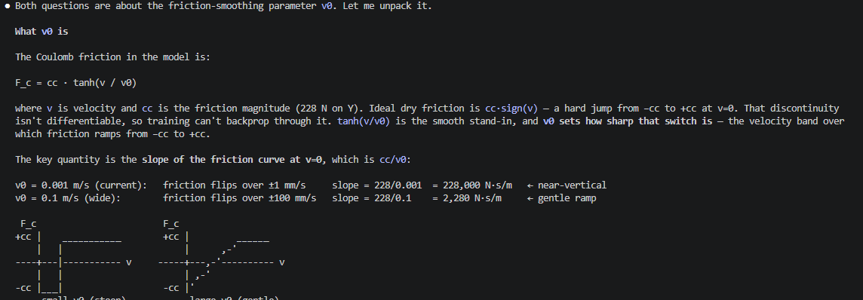
Tanh smoothing for coulomb friction

Slide 75
This is a strong thesis result on its own: the closed-loop test reveals that the ~300 Hz X structural mode is absent from the recovered model — a specific target for the augmentation to capture, and the reason CL cannot currently validate the model.

Slide 76
These aren't in tension because the DC does not come from the physics. It comes from the estimation setup. The optimizer is never asked to match the zero-mean true correction directly — it minimizes a windowed free-run loss on K=0 integrator states,

Slide 77
How can you say the system is actually zero mean, if i look at the correction the ANN should actually learn it's also zero mean. but as far as i know you can correct me, what the ANN learns is non zero mean.

Slide 78
Optimizer
Adam vs SGD

Slide 79
The chain of reasoning:- Our confirmed result: Adam amplifies a tiny, seed-consistent gradient in the DC direction (stage 2). Open question: why does that tiny gradient exist at all?- The report's hypothesis: it's truncated-BPTT bias, and that bias is non-decaying specifically because the X/Y axes are marginally stable — poles exactly at z=1 (λ→1). For a contractive mode (λ<1) the bias would decay; for a pure integrator it never does.- The pole-perturbation tests that hypothesis directly: add a small stiffness so the X/Y poles move from z=1 to z=1−δ (λ<1). If the DC then shrinks, marginal stability (λ=1) is confirmed as the source. If the DC is unchanged, the source is something else.

Slide 80
Updated figure
Laten zien hoe coulomb nu terug komt in de formules voorheen en nu
Zero mean problem uitleggen omdat alle initializatie around a zero mean is.
  Offset msd zou dit kunnen veroorzaken
  Laten zien dat het system daadwerkelijk zero mean is
  De juiste correctie is ook zero-mean
    Wat is dan het problem?

Slide 82
compute_normalization subtracts the mean and divides by std precisely to manufacture the zero-mean/unit-variance inputs that Xavier and tanh assume. But it uses one pooled normalization. Our data has multiple operating points (Y ≈ 0.1–0.3 m), so each record's normalized signal still carries an O(1) constant offset from the pooled mean — the zero-mean assumption is satisfied on average, but violated per record. That's the Theme-B mismatch.

Slide 83
These are closed-loop recorded signals, so "position ≈ setpoint" is partly the servo, not the physics. So label this as the as-recorded view and keep v1f (open-loop, same input) as the physics-clean backup — there a real DC would show as an unmissable ramp, and it came out ~1e-7.

